Slide 1
Name, Title | Session

Slide 2
DISCLOSURE
I have no relevant commercial relationships to disclose.

Slide 3
Epidemiology of Pain in Older Persons
Stephen Gibson
Caulfield Pain Management & Research Centre, Caulfield, Victoria, Australia.
email: s.gibson@cgmc.org.au

Slide 4
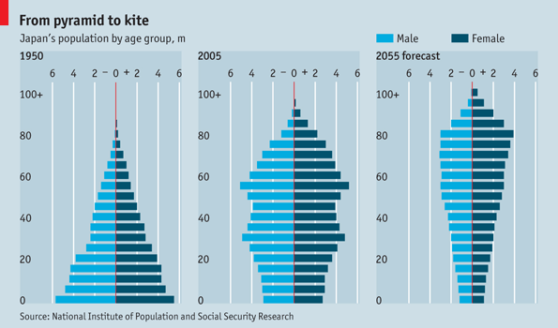
Change in the population pyramid

Slide 5
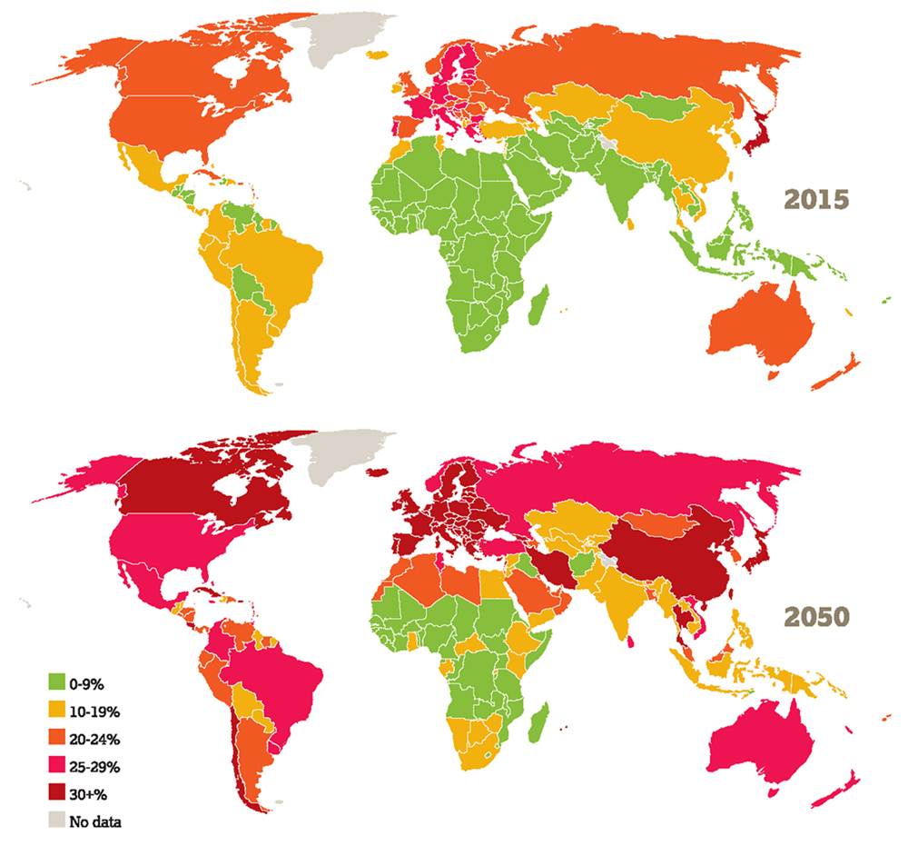
Population Ageing

Slide 6

Reasons for an ageing
population
Better public health.
Reduced mortality.
Better management of chronic disease.
Challenge to traditional view of longevity.
Centenarians increasing at 8%/year and death rates fallen by 1/3 in recent years.

Slide 7
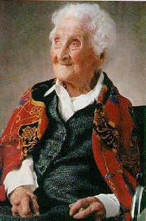
Oldest person died at 122.85 years
Jeanne Louise Calment was born in Arles, France on February 21, 1875.
She still rode her bike until 110 and gave up smoking at 117.
Quotes:
“In life one sometimes makes bad deals. ”
“I've only got one wrinkle and I'm sitting on it.”
Notes:
Comments on the notary public, Andre-Francois Raffray, who purchased her apartment, promising to pay $500 per month until Jeanne died. He paid twice the market value for the apartment before dying in December of 1995.
Jeanne Calment, the world's oldest person, died at 122 on Monday August 4, 1997.
Jeanne Calment signed a deal, common in France, to sell her condominium apartment "en viager" to lawyer François Raffray, then 47. Americans would call this a "reverse mortgage". Raffray agreed to pay a monthly sum until she passed away. She was then 90, and the value of the apartment was equal to ten years of payments. Unfortunately for Raffray, not only did she survive more than thirty years, but he died first, in December, 1995 at the age of 77. His wife had to continue the payments.
She said that in her younger years, she met Vincent van Gogh, later describing him as "dirty, badly dressed and disagreeable."
In 1985, Jeanne Calment moved into a nursing home, after living on her own until age 110.

Slide 8
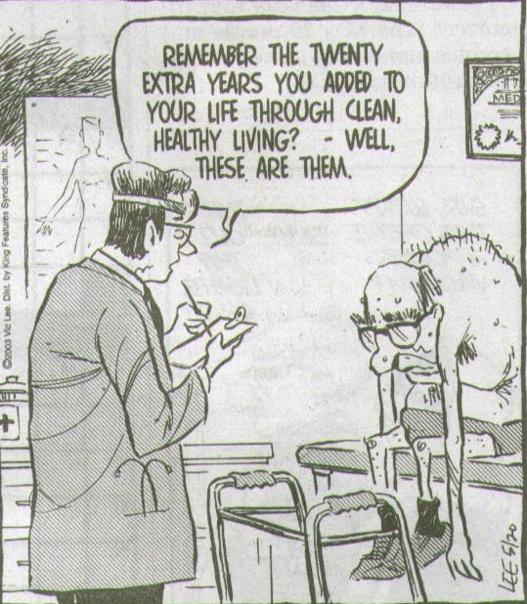

Slide 9
Pain prevalence across the life-span
50
25-65%
17-50%
25-56%
40
7-37%
Prevalence of Pain
30
20
10
20
30
40
50
60
70
80
90
Age

Slide 10
Prevalence of Pain in Nursing Home Residents
Adapted from Takai et al, Pain Management Nursing 2010
Studies = 27
Median size = 341
Total Residents = 2,249,882
Median prevalence = 52%
Notes:
Yukari Takai, DNSc, RN,*
Noriko Yamamoto-Mitani, PhD, RN,*
Yuko Okamoto, PhD, RN,* Keiko Koyama, PhD, MD,†
and Akiko Honda, PhD, RN‡
Pain Management Nursing, Vol 11, No 4 (December), 2010: pp 209-223
Pain is a common symptom among older residents of nursing homes
and can lead to adverse effects such as a decrease in the activities of
daily living and quality of life. Existing literature on the prevalence of
pain among older residents of nursing homes was reviewed. Of the
studies that were reviewed here, 27 met the criteria of this study, and
these were selected for further analysis. These studies were published
from 1990 to 2009. There was a slight increase in the number of studies
on this topic from 2004 onwards. It was clear that older residents
commonly suffer from pain and other serious problems related to
pain. The prevalence of pain in these studies appeared to be related to
the research methods and data sources used as well as to the time
frame of pain detection. Therefore, the results of such prevalence
studies should be interpreted cautiously. It was also reported that
higher pain intensity led to greater limitations in the activities of daily
living. Insufficient use of analgesics for treating residents with pain
was often reported, particularly in residents with a low cognitive status.
Health professionals should be aware of the serious issues related
to pain among nursing home residents and the fundamental right to
have pain assessed and treated to the greatest extent possible.
2010 by the American Society for Pain Management Nursing

Slide 11
Chronic Pain Prevalence by Age
Reasons for variability
  Sample frame. Pain window.
  Response rates. Pain duration.
  Method. Individual differences.
  - interview Questions asked:
  - postal - site(s)*
  - telephone - severity and impact*

Slide 12

Individual differences?

Slide 13
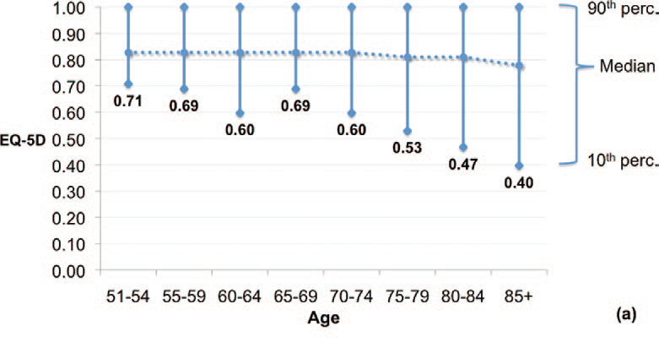
Heterogeneity in older populations
Lowwsky et al. J Gerontol. 1-10, 2013.
Health QofL: mobility, self care, activity, pain, anx/dep

Slide 14

LIFESPAN FACTORS IN PAIN
What impacts on pain vulnerability over the lifespan?
Early life trauma
(e.g., prematurity, illness, bullying, neglect
and abuse)
Illness – e.g., CVD, hypertension, arthritis, kidney, diabetes
Work / transport injury
Occupational demands
Social isolation
genetics
Sexual assault
Excessive body weight
Social disadvantage
Inactivity
Anxiety, depression
Female
Stress
Valentin et al. (2016) BMJ Open; 6: e007616

Slide 15
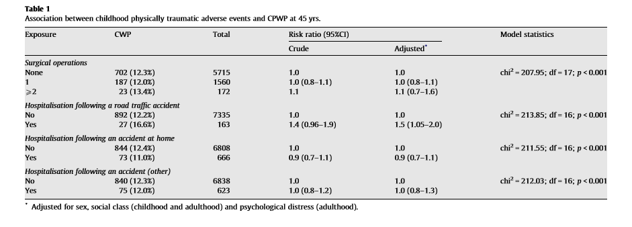
Childhood risk factors for subsequent widespread adult pain
Jones et al. Pain; 2009; 143 (1-2): 92-96. risk at age 7 compared to pain at 45 years

Slide 16
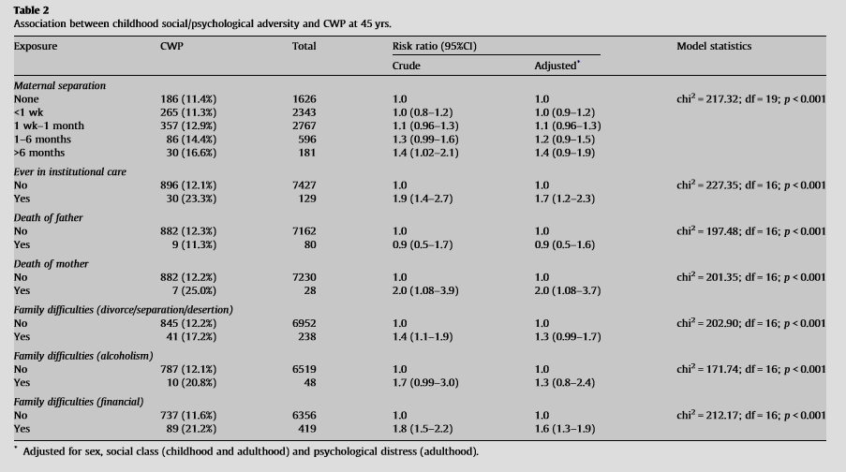
Childhood risk factors for subsequent widespread adult pain
Jones et al. Pain; 2009; 143 (1-2): 92-96.

Slide 17
LIFESPAN FACTORS IN PAIN
What impacts on pain vulnerability over the lifespan?
Early life trauma
(e.g., prematurity, illness, bullying, neglect
and abuse)
Illness – e.g., CVD, hypertension, arthritis, kidney, diabetes
Work / transport injury
Occupational demands
Social isolation
genetics
Sexual assault
Excessive body weight
Social disadvantage
Inactivity
Anxiety, depression
Female
Stress
Valentin et al. (2016) BMJ Open; 6: e007616

Slide 18
Prevalence of Radiographic OA
100
Hands
75
Knees
Feet
50
Prevalence (%)
25
0
18-24
25-34
35-44
45-54
55-64
65-74
75-79
Age Range (years)
NHANES Study 1993

Slide 19
Chronic Pain Prevalence by Age
Reasons for variability
  Sample frame. Pain window.
  Response rates. Pain duration.
  Method. Individual differences.
  - interview Questions asked:
  - postal - site(s)*
  - telephone - severity and impact*

Slide 20

EPIDEMIOLOGY OF PAIN OVER LIFESPAN
But lifespan prevalence varies across body regions
Postal Health Assessment Survey of UK General Practice patients
(n = 5,752)(Urwin, 1998)
Systematic review & meta-analysis
of back pain and age (Dionne, 2006)
Fayaz (2016) Systematic review & meta-analysis UK, BMJ Open, 6:e010364; Johannes et al (2010), J Pain;11:1230-1239
Urwin et al. (1998) Ann Rheum Dis;57:649–655; Dionne (2006), Age and Ageing; 35: 229–234

Slide 21
CHRONIC WIDESPREAD PAIN (WSP)
American College of Rheumatology Definition of WSP: Pain for >3m located axially (cervical/thoracic spine, anterior chest, low back), above/below waist, L/R side of body)
More common in women, increases to age 40-50 with further increase/plateaus into older age.
Sweden
Israel
Cheshire, UK
South Korea
Russia
Wichita, USA
Pooled prevalence: 10.6% (95% CI: 8.6-12.9)
Mansfield (2016) Systematic rvw & meta-analysis, Pain, 157: 55-64

Slide 22
Prevalence of Cardiac Pain
25
Males
Females
20
15
Prevalence (%)
10
0
18-24
25-34
35-44
45-54
55-64
65-74
75-79
Age Range (years)
Von Korff et al. 1988, n= 1016

Slide 23
Prevalence of Abdominal Pain
40
Males
Females
30
20
Prevalence (%)
10
0
18-24
25-34
35-44
45-54
55-64
65-74
75-79
Age Range (years)
Kay et al. 1994, n= 3608

Slide 24
Chronic Pain Prevalence by Age
Reasons for variability
  Sample frame. Pain window.
  Response rates. Pain duration.
  Method. Individual differences.
  - interview Questions asked:
  - postal - site(s)*
  - telephone - severity and impact*

Slide 25

Biopsychosocial impacts of chronic pain
“But Dr, I can’t learn to live with it!”

Slide 26
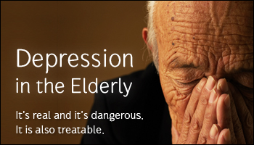
Disturbed Mood
40%-70% of older persons with pain have depression. 2.6 times more likely to suicide

Slide 27
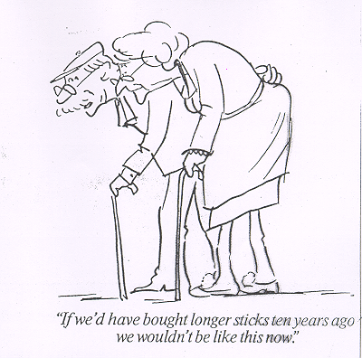
Impacts on function

Slide 28
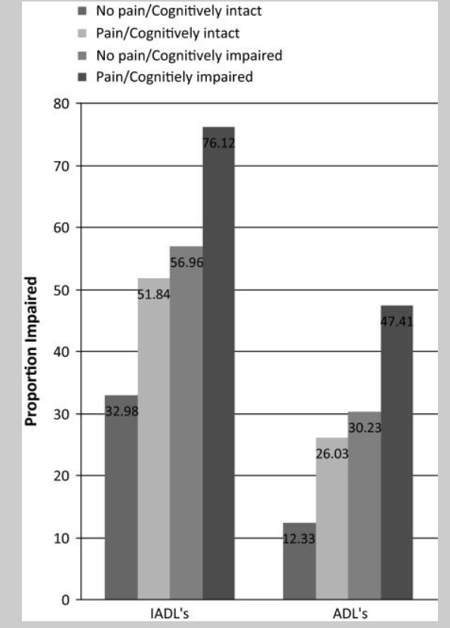
Pain impact on function
IADL: getting to distant places,
using phone, shop, cook, housework
ADL: eat, dress, personal care, walk,
get out of bed, bathing, toilet.
Functionally impaired = needing help
on at least one item.
N = 5,143
Shega et al. J Gerontol. (Med);
2010; 65(8); 880-886.

Slide 29
Other impacts of persistent pain
Sleep
Neurocognitive performance
Addiction-polypharmacy
Financial stress
Social relationships
Physical health
Quality of life

Slide 30
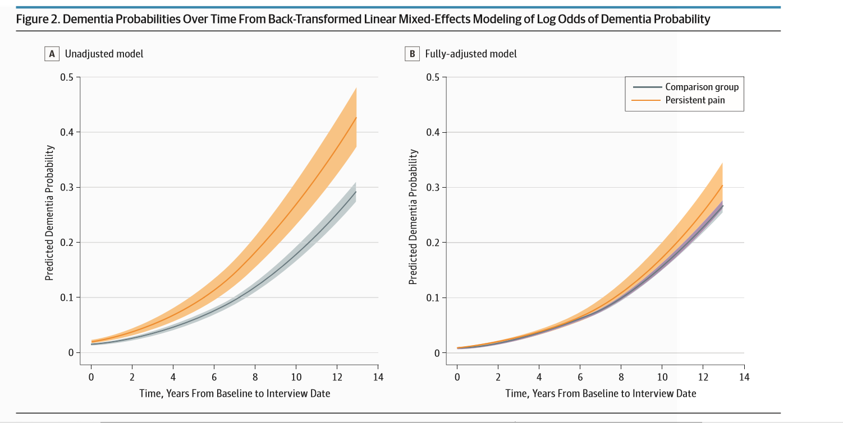
Whitlock et al. (2017) JAMA InternMed.doi:10.1001/jamainternmed.2017.1622
After 10 years translates to a 2.2% increase in probability of dementia diagnosis
Notes:
Whitlock et al. (2017) JAMA InternMed.doi:10.1001/jamainternmed.2017.1622

Slide 31
Other impacts of persistent pain
Sleep
Neurocognitive performance
Addiction-polypharmacy
Financial stress
Social relationships
Physical health
Quality of life

Slide 32
Prevalence of pain requiring clinical assistance.
There have been relatively few studies to examine the prevalence of “clinically relevant” or “clinically significant” pain as a function age (Helme & Gibson 1999, Smith et al 2001, Brevick et al. 2006,Nahin 2015).
  Findings suggest approx. 10%-21% of older adults suffer from pain requiring clinical assistance and this prevalence is estimated to be 2-4 times more common in adults of advanced.

Slide 33
HSOP data on pain severity
N = 1000
Helme & Gibson, Epidemiology of Pain, IASP press 1999

Slide 34
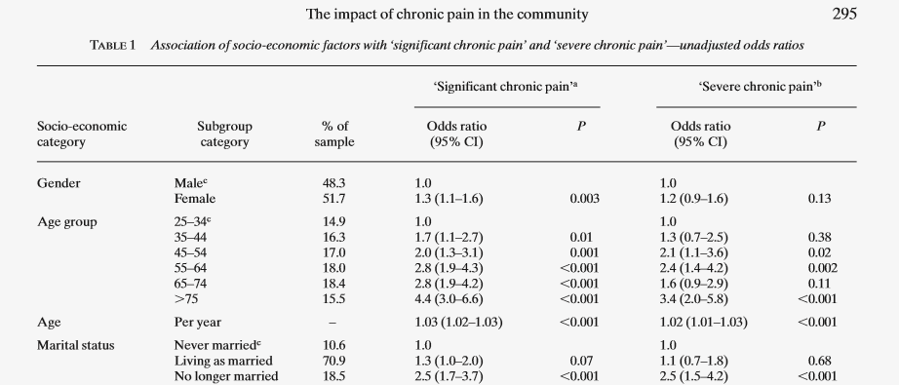
Age difference in significant chronic pain
Smith et al. Family Practice, 2001, 18(3): 292-299

Slide 35
  Conclusions and future directions
  Pain prevalence increases until at least late middle-age and then reaches plateau or may even decline somewhat in the “oldest” old.
  Pain is very common in the older population affecting approx 50% and this is at least twice the rate as found in younger adults.
  Sites most affected by pain in older people are the joints, legs and feet. Pain associated with visceral disorders appears to decline in old age.

Slide 36
  Conclusions and future directions
  There are very few studies that categorize pain by severity/impact in older cohorts and therefore the potential need for clinical services in this population remains relatively unknow. However, on the limited available evidence approx 15-20% of older persons will have pain requiring at least some clinical assistance.
  Epidemiological studies of pain in the “oldest old” are lacking and data on pain in the 90+y are non-existent. Given the ageing of the world’s population such information will be vital in order to inform future clinical practice for this rapidly growing segment of our population.

Slide 37
THANK YOU!

