Slide 1
Keela Herr, PhD, RN, Assessment of Pain in Older Adults| Pain and Aging Preconference

Slide 2
DISCLOSURE(S)
Research Support: | National Institutes for Health (NIH) Health Resources and Services Administration (HRSA) The Mayday Fund Csomay Center for Gerontological Excellence
Consultant: | NA

Slide 3
Objectives
Discuss best practice recommendations for assessment of pain in older adults.
Identify key challenges, resources and future directions for improving pain assessment in older adults.

Slide 4
Goals of Clinical Assessment of Pain
To recognize the existence of pain
To characterize an individual’s pain by type and quality, location, intensity, and etiology.
  Single most reliable indicator of the existence and intensity of pain is the individual’s self report
To identify impact of pain on function and quality of life
Notes:
Herr, K.
7/25/17
4

Slide 5
Domains of Comprehensive Pain Assessment in Older Adults
Self-reports (uni and multidimensional) & behavioral observationf5
Psychosocial comorbidities and complicating factors, cognitive processes, coping, affective processes, interpersonal processes
Physical exam, pharm eval, age-related physical concerns, sensory impairment, functional assessment
Initial determination or ongoing monitoring of pain
Medical, pharmacologic, and functional assessment of pain-related concerns
Assessment of psychosocial factors contributing to pain complaint
Hadjistavropoulos et al., 2007. Interdisciplinary expert consensus statement on
assessment of pain in older persons. Clin J Pain, 23(1):S5
Notes:
Framework for assessment—multicomponent process—how to implement more comprehensive pain measurement tools in clinical setting
Complex process that requires TIME—and TIME and LACK OF KNOWLEDGE are two of biggest reported barriers to adoption of pain assessment tools/protocols
Pain tools help us identify and quantify pain
Most attention clinically on pain intensity rating—necessary step but sufficient? Does it address individual variability?
Other assessments/follow-ups necessary
Focus on intensity and nonverbal tools AND raise questions about the utility of our current approaches as part of this initial determination of pain in OA who can and can’t self-report
TOOLS FIT WITH IMMPACT recommendations-use of sound research tools that are clinically usable
Getting them into procedures/documentation systems key
Pain multidimensional--Need a holistic approach to assessment. It is not just a sensory experience and necessitates more than an intensity scale. This slide summarizes some key areas to incorporate into a comprehensive assessment.
Diagnosis is essential first step. Pain from other etiologies besides cancer.
Lab and Diagnostic testing useful to some extent to determine etiology--
Assessment of the older adult with persistent pain must also include evaluation of physical function (e.g., impairment in performance of basic/instrumental/advanced activities of daily living, sleep and appetite), psychosocial function (e.g., mood, interpersonal interactions, fear of pain-related activity) and cognitive function (e.g., acute or subacute confusion, beliefs about pain) . Because these functional consequences of pain can themselves modify the pain experience (e.g., depressed and/or sleep deprived individuals tolerate pain less well, those with fear of activity are more prone to becoming disabled, and those with cognitive dysfunction may be more difficult to treat), their specific treatment is a key element in effective management of persistent pain.
However, pain intensity is most common component evaluated. Need to do in manner sensitive to needs of older adults.

Slide 6
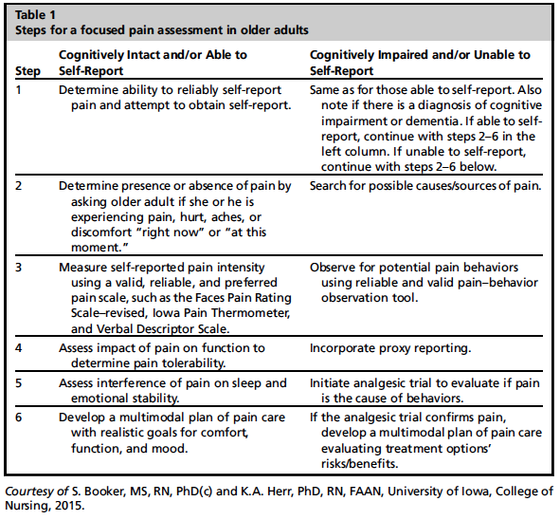
Booker & Herr (2017). Assessment and measurement of pain in adults in later life. Clinic of Geriatr Med, 32; 677-692.

Slide 7
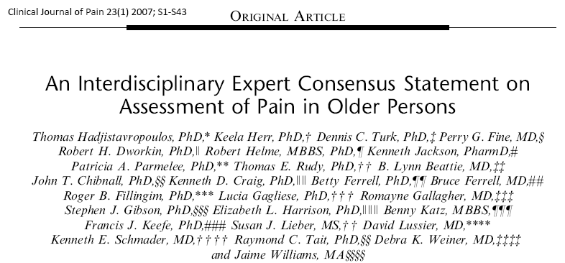
Reliable & Valid Pain Intensity Tools for Older Adults?
Number of tools evaluated in older adults
Further support in last decade

Slide 8
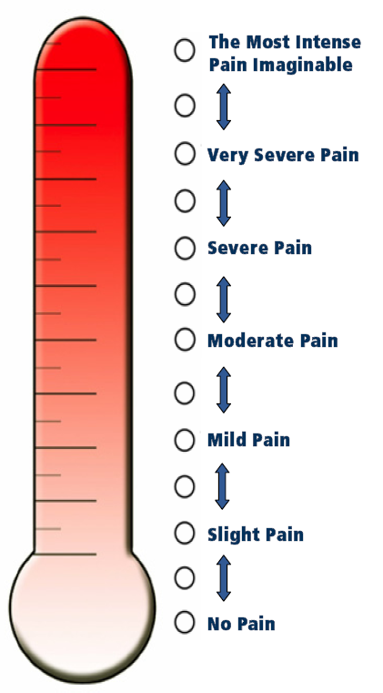
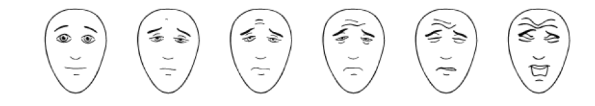
Selected Pain Intensity Scales for Older Adults
(Gagliese et al., 2005; Herr et al., 2007; Lukas et al., 2013;
Personen et al., 2009; Wood et al., 2010; Ware et al., 2015)
Simple VDS
0 = None
1 = Mild
2 = Moderate
3 = Severe
(Closs et al., 2004)
Verbal Descriptor Scale (VDS)
___ Most Intense Pain Imaginable
___ Very Severe Pain
___ Severe Pain
___ Moderate Pain
___ Mild Pain
___ Slight Pain
___ No Pain
(Herr et al., 2004)
McGill Present Pain Inventory (PPI)
0 = No pain
1 = Mild
2 = Discomforting
3 = Distressing
4 = Horrible
5 = Excruciating
(Melzack & Katz, 1992)
Iowa Pain Thermometer
NRS
Faces Pain Scale-Revised
(Hicks et al., 2001)
(Herr et al., 2007)
Notes:
NOTE: Core outcome domains for chronic pain clinical trials: IMMPACT recommendations. Pain, 2003;106:337-345. Recommends 4-point VDS for cognitively impaired
R-FPS FPS-r preferred by African American, Hispanics and Chinese Older Adults
Ware et al., Pain Mgt Nsg, 2006; 7(3):117-125; Liu & Li, Chinese J of Nsg, 2004; 39(3):165; Li et al., Pain Med, 2007; 8(3):241-249 ; Li et al., J Nsg Schol, 2009, 41(3):241-249)

Slide 9
Iowa Pain Thermometer-Revised
Preliminary reliability and validity in 75 older adults, varying cognitive function
Preferred over NRS by 57% intact; 61% impaired
Preferred by Caucasian and African Americans
Ware et al. (2015). Pain Mgt Nsg, 16(4), 475-482

Slide 10
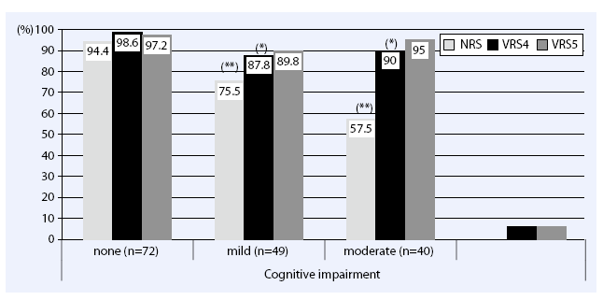
Do we have reliable and valid pain intensity tools for use with cognitively impaired older adults?
Geriatric hospital, 178 pts (Lukas et al, 2013)
  Good cross tool correlations;
    Lower @ rest, than movement
  Most stable tool with increasing CI: VRS
  Level of impairment for inability to use (MMSE 10)
Notes:
Lukas et al (2013) Self- and proxy report for the assessment of pain in patients with and without cognitive impairment. Z Gerontol Geriat
% able to complete each scale with max 2 explanations
11 pt NRS, 5 pt VRS (none, mild, moderate, severe, very severe), and 4 pt VRS (none, mild, moderate, severe)
MMSE None: 30-25 Mild CI: 24-28 Moderate: 17-10 Severe: 9-0
At least 90% able to complete VRS 4 and VRS 5

Slide 11
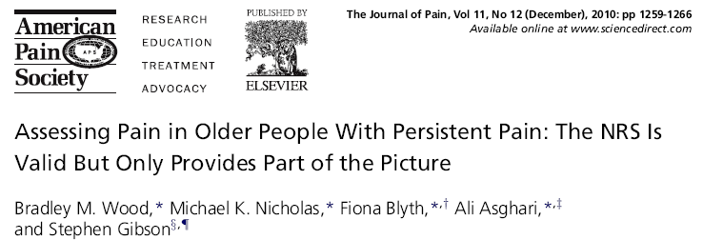
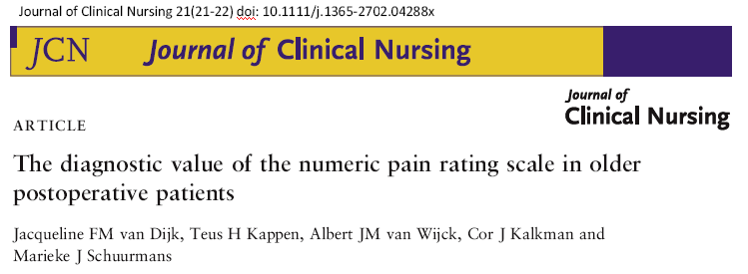
Largest study (800) community elders attending tertiary pain clinic
NRS as valid and reliable tool for measuring pain intensity and distress;
Sign correlations with other pain measures, but not affective distress;
Failure rates significantly increase with increasing age
5.5% in 61-70
7.8% 71-80
11.1% in >81
CANNOT RELY
SOLELY ON NRS
75% over 75 yrs with reported ‘painful but bearable’ equated NRS 4, 5, 6 this category
Question standard cut-offs?
Notes:
Examined NRS only, along with relationship between NRS and other measures of pain MPI, Sf36, Depression, Anxiety and Stress Scale
Even highest failure rate shows 90% could use NRS—although sample community older adults attending tertiary pain center may be higher functioning
Van Dijk et al., J Clin Nsg, 2012; 3018. Documented different cutpoints on NRS relate to “unbearable” judgment by older postop pt. Thus established cutpoint could lead to over treatment
CANNOT RELY SOLELY ON NRS -- Need for communication regarding treatment needs
Need for measuring other dimensions of pain, including physical and emotional functioning, clinically feasible
NRS not same as generalised affective distress—important to assess pain specific affective distress and generalized affective distress
High correlation between pain intensity and pain distress suggest don’t need both
Need to assess range of dimensions recommended by IMMPACT group—appropriate for research but what about ciinical practice?

Slide 12
Can we improve our clinical assessment approach?
Pain intensity—5th Vital Sign
  Backlash from patients related to repetitive assessments that don’t fully capture their experience
  More patient-centered approach?
Pain impact scales—too time consuming?
  Brief Pain Inventory—SF and adapted
  Pain Disability Index
  Geriatric Pain Measure--Short Form (GPM-12)
Interview—lack consistency?
  Informal questioning—underestimates pain (Lorenz et al 2009; van Dijk et al; 2012)
  Pain Question phrasing (McGuire et al., 2009)
Emphasis on impact/tolerability/satisfaction with treatment plan?
Notes:
Evidence of lack of fidelity in scale administration—staff used informal queries “is your knee good today?” in 50% cases—associated with underestimation
Betty comment: Those pain scales are funny. I base my rating on whether or not I want a change in my medications—I make my score higher if I want a higher dose or other treatment and lower if I am doing OK with my plan.

Slide 13
Functional Assessment
Physical and Psychosocial function
  Standard tools available for geriatrics
    Physical function: ROM, Katz ADL, Lawton IADL
    Psychological function: Geriatric Depression Scale
    Cognitive function: MMSE, Mini-Cog
  Impact of pain on life activities/quality of life
    Brief Pain Inventory (Budnick et al., J Pain, 17, 2016)
    Pain Disability Index
    Geriatric Pain Measure (GPM) & GPM Short Form (GPM-12) (Blozik et al., JAGS, 55, 2007)

Slide 14
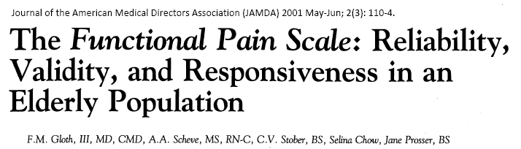
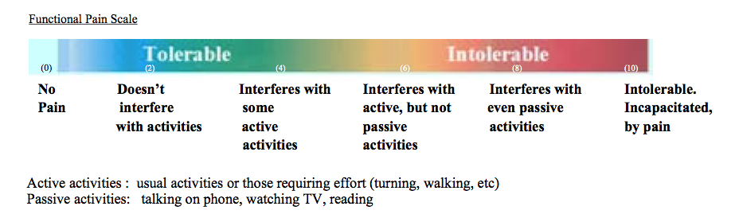
Other Approaches
  Functional Pain Scale (Gloth et al, 2001)
    0 No Pain
    1 Tolerable (and doesn’t prevent any activities)
    2 Tolerable (but does prevent some activities)
    3 Intolerable (but can use telephone, watch TV, or read)
    4 Intolerable (but can’t use telephone, watch TV, or read)
    5 Intolerable (and unable to verbally communicate because of pain)
Adapted Functional Pain Scale Used with permission P. Arnstein
Notes:
Lorenz et al (2009). J ABFM, 22:291-Study of Veterans HELP-Vets study in 19 clinics
Clinically Aligned Pain Assessment (CAPA) Questions
Comfort—intolerable, tolerable with discomfort, comfortably manageable, negligible pain
Change in pain—getting worse, about the same, getting better
Pain Control—inadequate pain control, effective, just about right, would like to reduce medication
Functioning, for the usual things you do—can’t do anything because of pain, pain keeps me from doing most of what I need to do, cam do most things, but pain gets I the ay of some, can do everything I need to
Sleep-is pain waking you up—wake with pain most of the night, awake with occasional pain, normal sleep

Slide 15
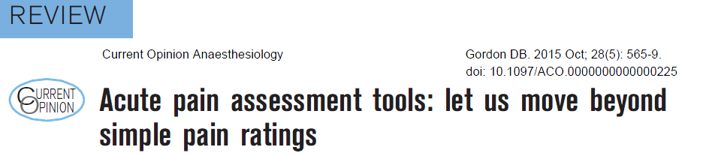
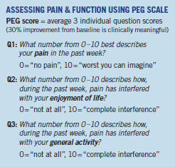

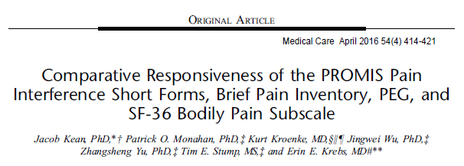

Slide 16
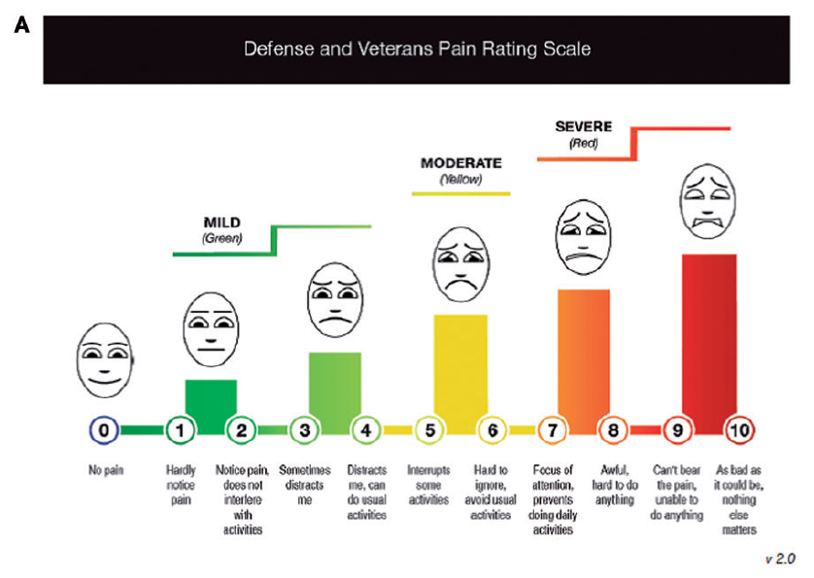

Slide 17
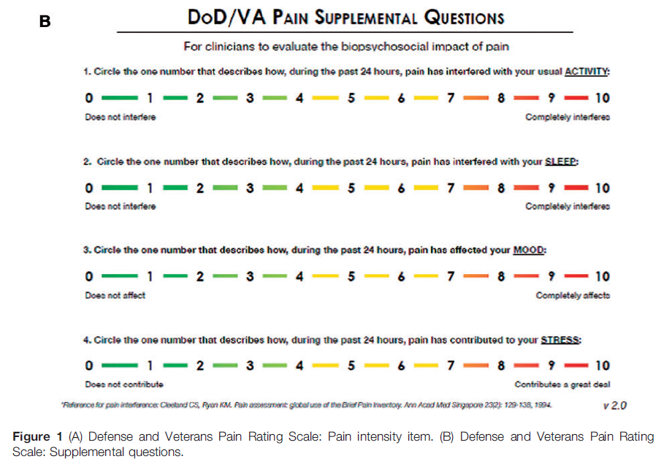

Slide 18
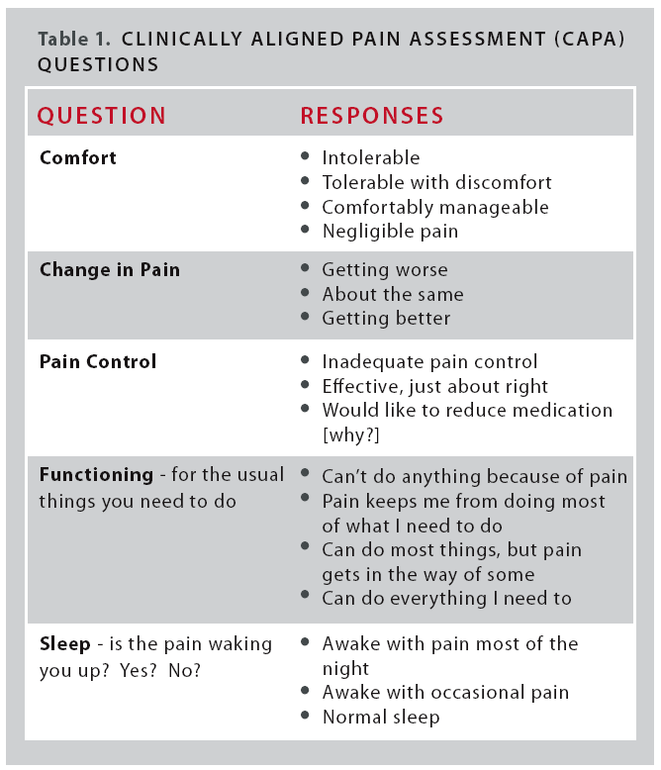
Patient’s Pain Experience--More than a Number
CAPA is a process of gathering specific assessment information during the course of natural conversation
Patients preferred over NRS by 5:1
Nurses preferred CAPA by 3:1
Classifying clinical pain—42% to 81%
Improved Press Ganey scores on How well pain was controlled from
  18% to 95%
Used with permission, Gary Donaldson, PhD, University of Utah Hospital & Clinics/Department of Anesthesia

Slide 19
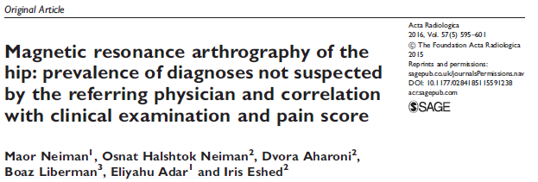

Slide 20

Search for Potential Causes of Pain
(Herr et al., 2011)
History and physical examination
  Establish definitive diagnosis if possible
    Focus on location of pain
    Pathological conditions and common procedures known to be painful
      E.g. Inflammation, infection (pneumonia, UTI, skin), incision, fracture, bladder distention, skin breakdown/irritation, constipation
      E.g. surgery, wound care, rehabilitation activities, positioning/turning, blood draws
    Common sites of pain and pain referral, esp. musculoskeletal and neurological systems
    Pertinent laboratory and other diagnostic tests
    Coexisting disease and medication review
Notes:
Herr, K.
7/25/17
20

Slide 21
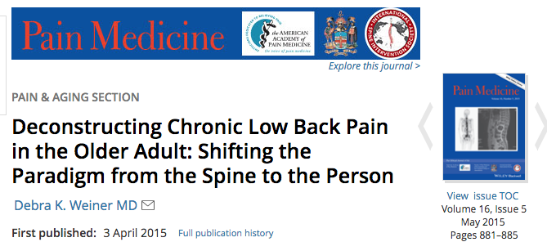
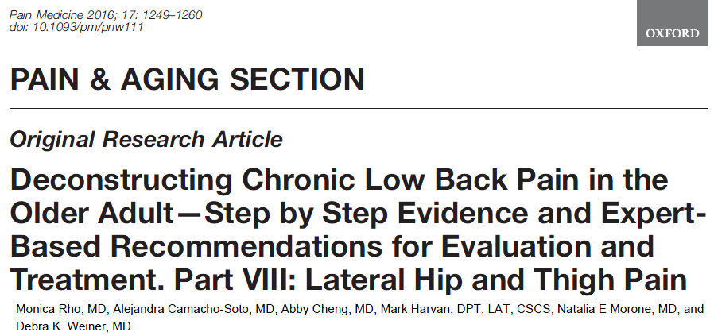
Part 1. Hip osteoarthritis
Part II. Myofascial
Part III. Fibromyalgia
Part IV. Depression
Part V. Maladaptive Coping
Part VI. Lumbar Spinal Stenosis
Part VII. Insomnia
Part VIII. Lateral Hip and Thigh Pain
Part IX. Anxiety
Part X. Sacroiliac Joint Syndrome
Part XI. Dementia
Part XII. Leg Length Discrepancy

Slide 22

Pain in Dementia: A Puzzle

Slide 23
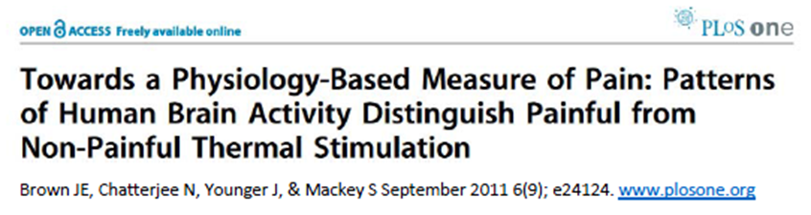
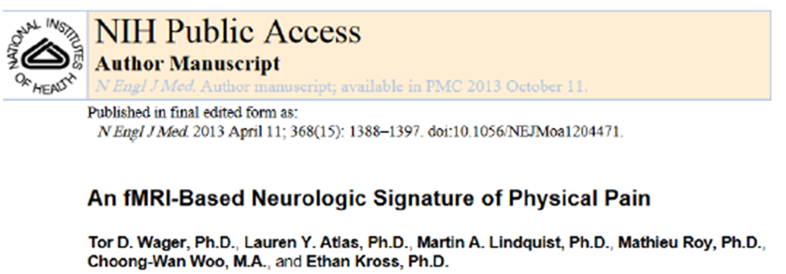

Clinically valid, physiological measure of pain for dementia?
Biomarkers-neuropeptides
(Sowa et al., 2014)
Schiavenato Pain Orb

Slide 24
Hierarchy of Pain Assessment Techniques
Patient self report
Potential causes of pain (acute and chronic)
Pain behaviors
Surrogate report and behavior change
Response to analgesic trial
Herr et al:, Assessment of Pain in Nonverbal Patients, Pain Mgmt Nurs, 2011
Hadjistavropoulos et al, Interdisc Expert Consensus State., Clin J Pain, 2007

Slide 25
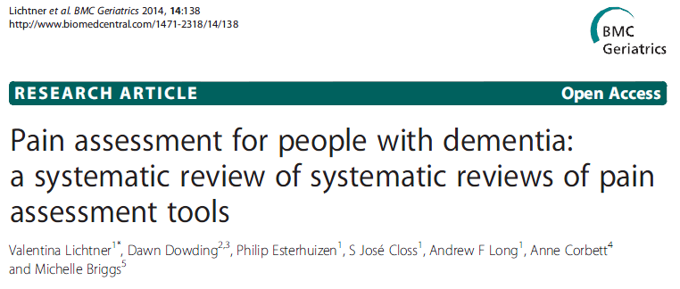
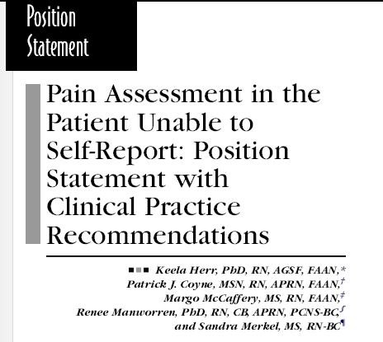
Reliable and Valid Tools for Pain Behavior Assessment in Severely Impaired Older Persons?
Now over 35 nonverbal pain tools
Reviews
  Corbett et al., (2012). Rev Neurol, 8:264
  Herr et al., (2010). J Geron Nsg, 36:18
  Cohen-Mansfield (2008), Alzh Dis Assoc Disord, 22(1): 86
  Aubin et al. (2007). Pain Res Manag, 12:195
  Van Herk et al. (2007). Nurs Res, 56:34
  Herr et al., (2006). J Pain Symptom Manage, 31:170
  Zwakhalen et al. (2006). BMC Geriatr, 6:3
No single best tool for all settings

Slide 26
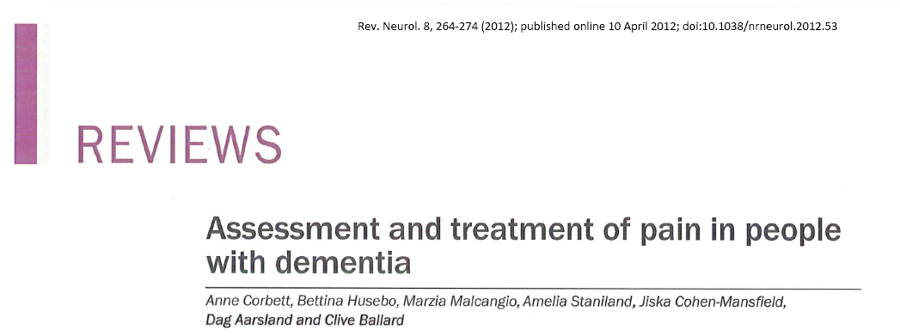
Caregiver or informant rating
    Abbey Pain Scale (Abbey) (Abbey et al., 2004)
    Pain Assessment for the Dementing Elderly (PADE) (Villaneuva et al., 2003)
    Pain Assessment in Noncommunicative Elderly Patients (PAINE) (Cohen-Mansfield, 2006)
    Pain Assessment for the Communicatively Impaired Elderly (PACI) (Kaasalainen et al., 2011)
  Observational rating
    Algoplus (Rat et al., 2011)
    Discomfort Scale for Dementia of Alzheimer’s Type (DS-DAT) (Hurley et al., 1992)
    Checklist of Nonverbal Pain Indicators (CNPI) (Feldt,2000)
    CNA Pain Assessment Tool (CPAT) (Cervo et al., 2012)
    Doloplus 2 (Wary, B. and the Doloplus Group, 2001)
    Elderly Caring Assessment 2 (EPCA-2) (Morello et al., 2007)
    Mobilization-Observation-Behavior-Intensity-Dementia Pain Scale (MOBID-2) (Husebo et al., 2011)
    Nursing Assistant-Administered Instrument to Assess Pain in Demented Individuals (NOPPAIN) (Snow et al., 2004)
    Pain Assessment in Advanced Dementia (PAINAD) Scale (Warden et al., 2003)
    Pain Assessment Checklist for Seniors with Severe Dementia (PACSLAC) (Fuchs-Lacelle et al., 2004)
    Pain Assessment Checklist for Seniors with Severe Dementia-Dutch (PACSLAC-D) (Zwakhalen, Hamers & Bergen, 2007)
    Rotterdam Elderly Pain Observation Scale (REPOS) (van Herk et al., 2009)
Most Recommended
PACSLAC
PAINAD
ABBEY
DOLOPLUS-2
MOBID
DS-DAT

Slide 27
Comprehensive Behavior Tool vs Brief Direct Observation?
Tools range from 5 behavioral categories to 60 individual behaviors—
  rating presence vs intensity
  Variable use and definition of behaviors
Are there key behaviors that will ID pain in most persons with dementia?
Goal to identify most specific indicators of pain in nonverbal older persons without missing pain in those with less typical behaviors

Slide 28
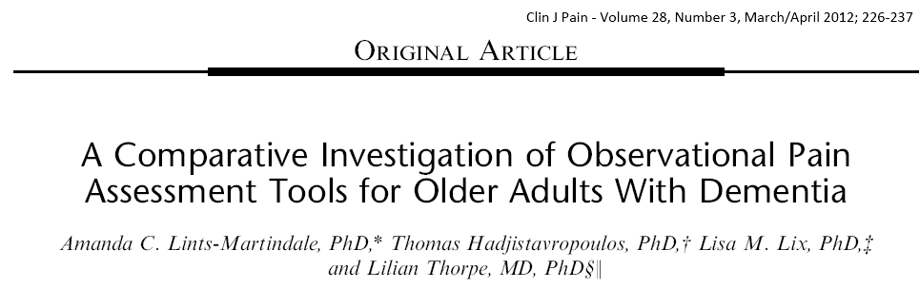
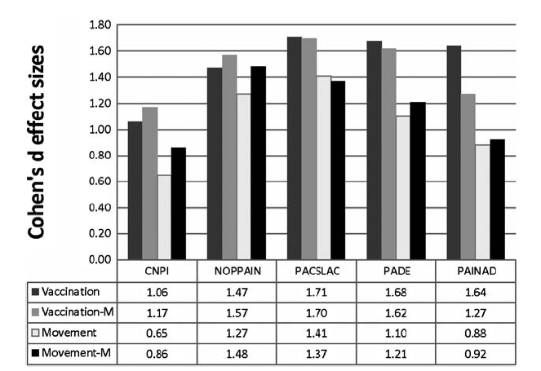
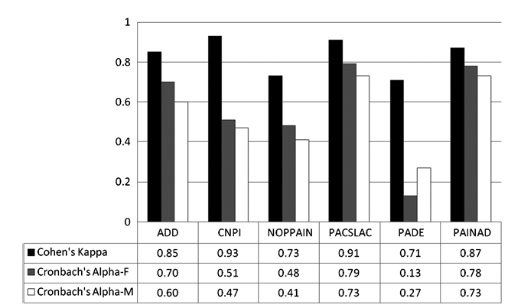
Compared 6 observational tools in 124 LTC residents with moderate to severe dementia
All measures differentiated pain and baseline conditions
  even after delirium-related items deleted
  Variable reliability and validity, and effect size
Effect size strongest with tools having behaviors in more domains
No sign relationship b/t self-report and observation measures
Behaviors NOT same
as pain intensity
F-flu immunization pain; M=movement pain
Notes:
Interrater reliability and internal consistency
All measures differentiated pain and baseline conditions
even after delirium-related items deleted
Variable reliability and validity, and effect size
No sign relationship b/t self-report and observation measures
Behaviors NOT same
as pain intensity

Slide 29
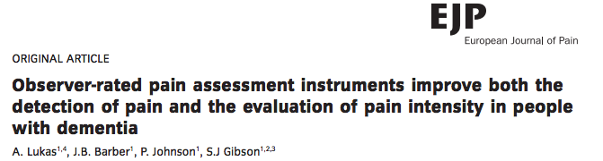
2013; 1558-68
Comparison of Abbey, PAINAD, NOPPAIN with self-report
All three scales increased recognition of pain in both patients with dementia and cognitively intact
Scales improved classification of pain intensity—but considerable false alarms and misses

Slide 30
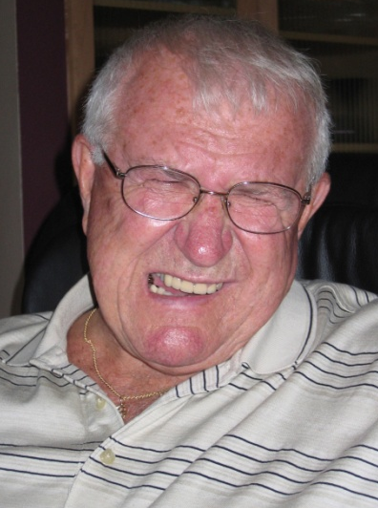
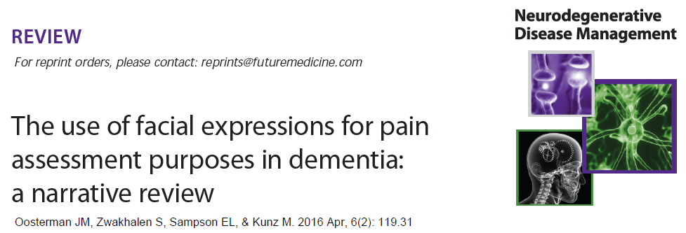
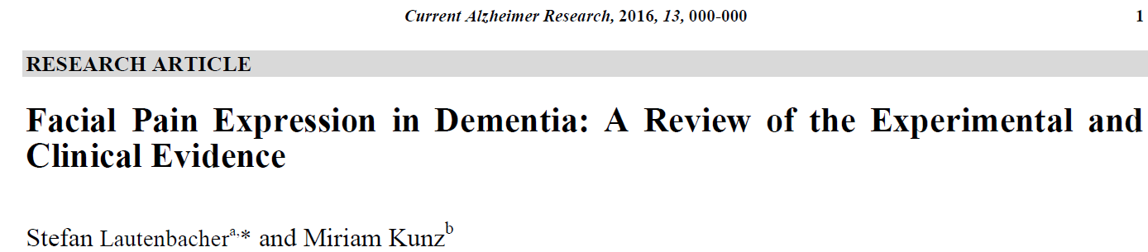
Facial Grimace:
Key Pain Behavior?

Slide 31
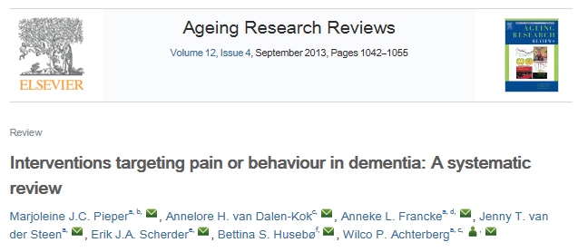
Support of Atypical Pain Behaviors Growing
Pain interventions effective in reducing pain and behavioral symptoms, such as depression, agitation/aggression, anxiety

Slide 32

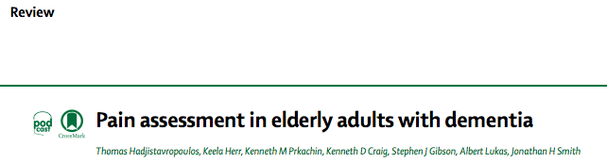
Recent Reviews or Resources
Chapter 9 Methods of Assessing Pain and Associated Conditions in Dementia: Self-Report Scales
Chapter 10 Observational Pain Tools
Chapter 13 Guidelines and Practical Approaches for Effective Pain Assessment of Pt with Dementia
2017
Lancet Neurol 2014; 13:1216-27.

Slide 33
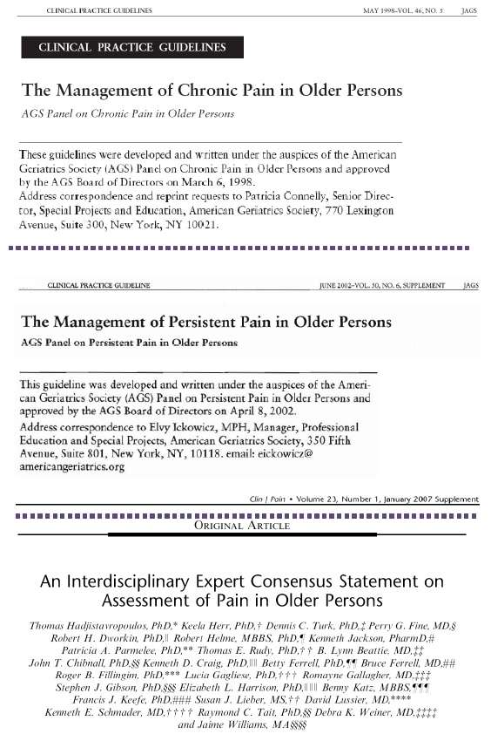
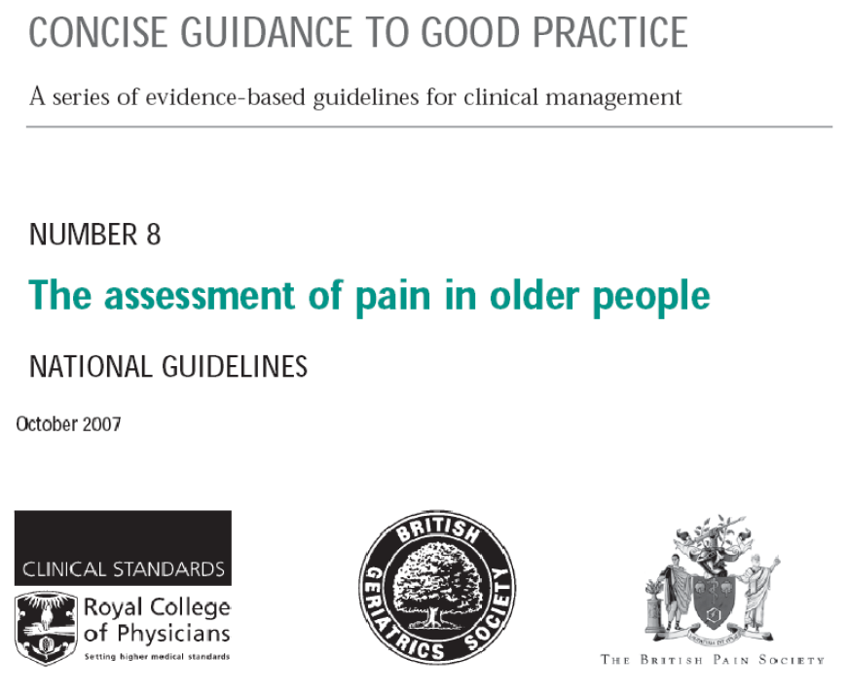
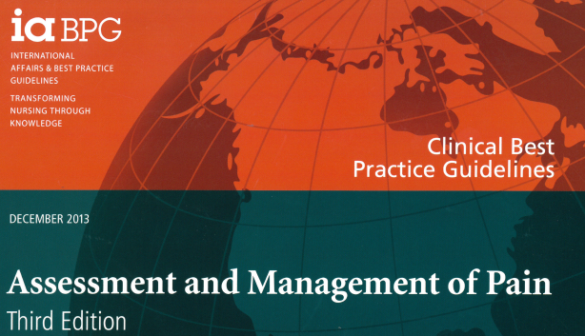
Guidelines and Position Statements on Pain Assessment in Older Adults
Pain Mgt Nsg, 2011, 12(4):230-50
2nd ed in process

Slide 34

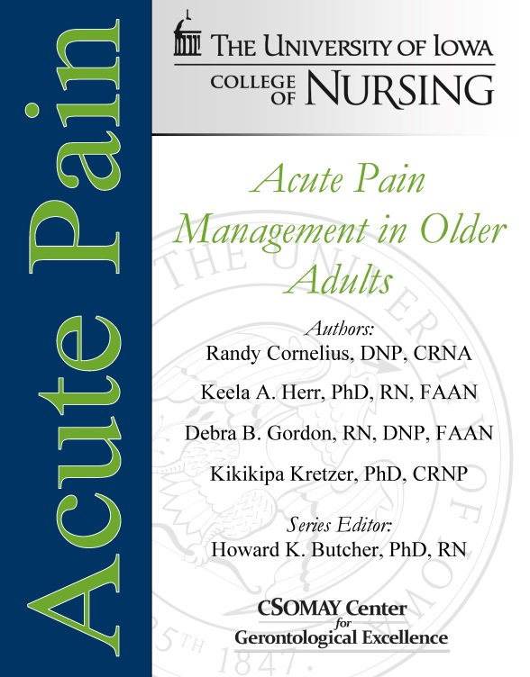
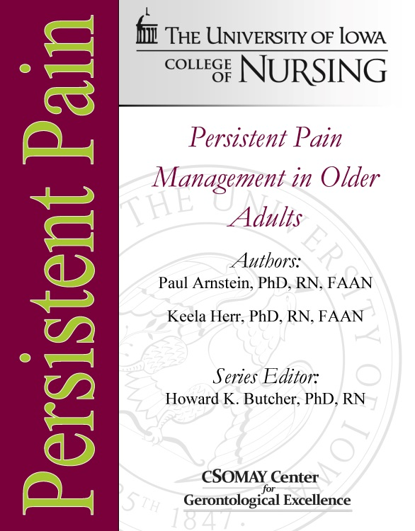
University of Iowa
College of Nursing
NEW Evidence-Based Practice Guidelines
www.IowaNursingGuidelines.com

Slide 36


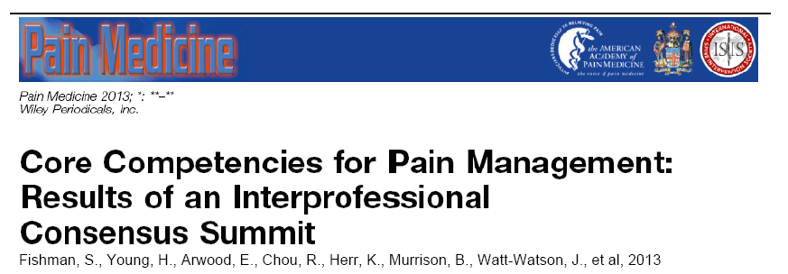
Education is a Key Step in Improving Pain Practice
Led by Dr. Judy Watt-Watson
Funded by The Mayday Fund

Slide 37

Pain Core Competency Meeting at IASP 2016
Global representatives to discuss
Meeting of international stakeholders to discuss how to advance competency-based pain education in the future
For info: hs-capr@ucdavis.edu

Slide 38

Resources to Enhance Education
NIH Pain Consortium partnership with 11 schools
Centers of Excellence in Pain Education (CoEPE)
Develop, evaluate and distribute pain management curriculum resources for health professional schools
Includes older adult cases
The 11 CoEPE awardees are:
University of Alabama-Birmingham
University of California-San Francisco
Harvard University
University of Connecticut
University of Iowa
Johns Hopkins University
University of Pennsylvania
University of Pittsburgh
University of Rochester
Southern Illinois University Edwardsville
University of Washington

Slide 39

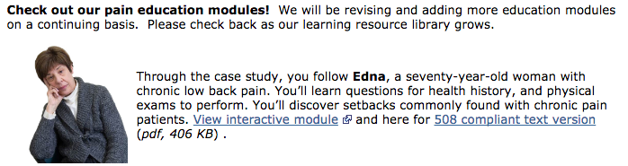
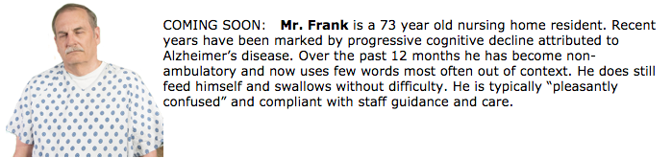
https://painconsortium.nih.gov/nih_pain_programs/coepes.html

Slide 40


Slide 41
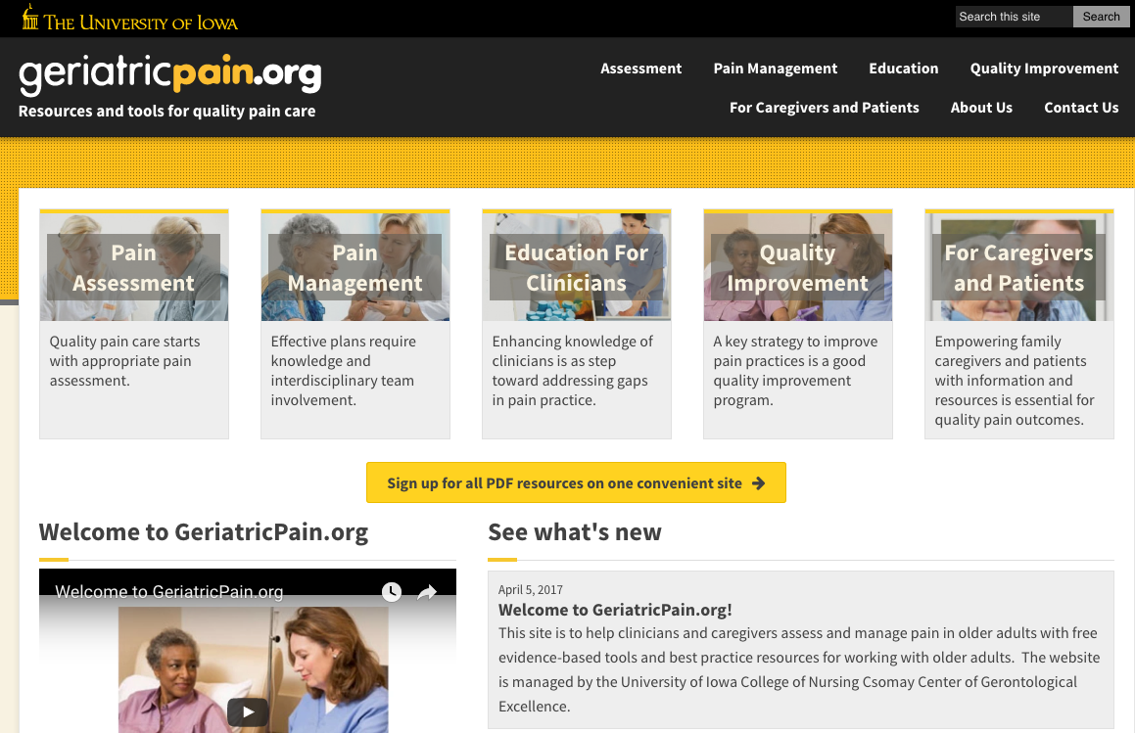
Current funding support from The Mayday Fund, Csomay Center for Gerontological Excellence

Slide 42
Key Issues
Assessment tools capturing relevant domains of pain and its impact
Addressing cultural relevance
  (Booker, Herr, Reimer, W J Nsg Res, 2016, 38:1354-73)
Tool sensitivity to response to treatment
Interpretation of nonverbal pain scores
  Use of assessment data to guide tailored treatment
Implementation of best practices
  Education
  Strategies to change provider practices

Slide 43
THANK YOU!

