Slide 1
Pain & Aging: Measurement, Management & Mechanisms

Slide 2
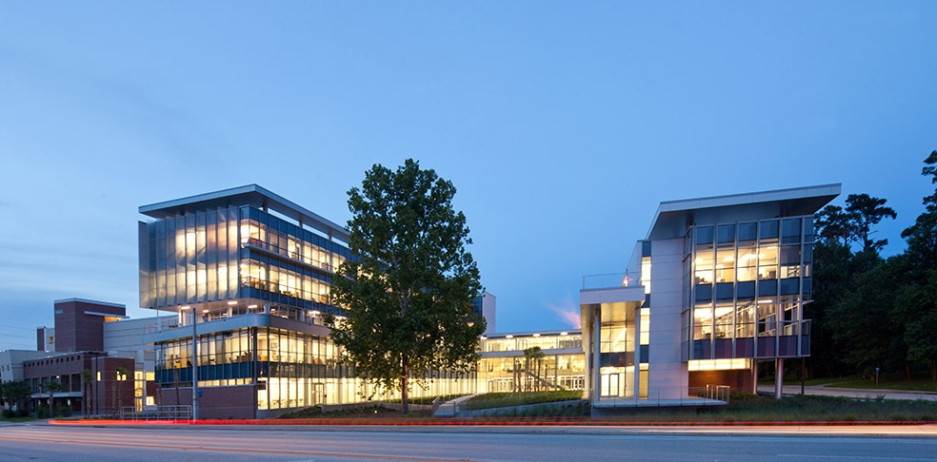
Welcome & Introduction
Roger B. Fillingim, PhD
Distinguished Professor, College of Dentistry
Director, Pain Research & Intervention
Center of Excellence (PRICE)
University of Florida

Slide 3
DISCLOSURE(S)
Research Support: | NIA (AG033906, AG046371), NIDCR (DE017018, DE024169), and CTSA Grant (TR001427)
Consultant: | None
Discussion of Off-Label, Investigational, or Experimental Drug Use: | None

Slide 5
Pain in Older Persons Special Interest Group

Slide 6
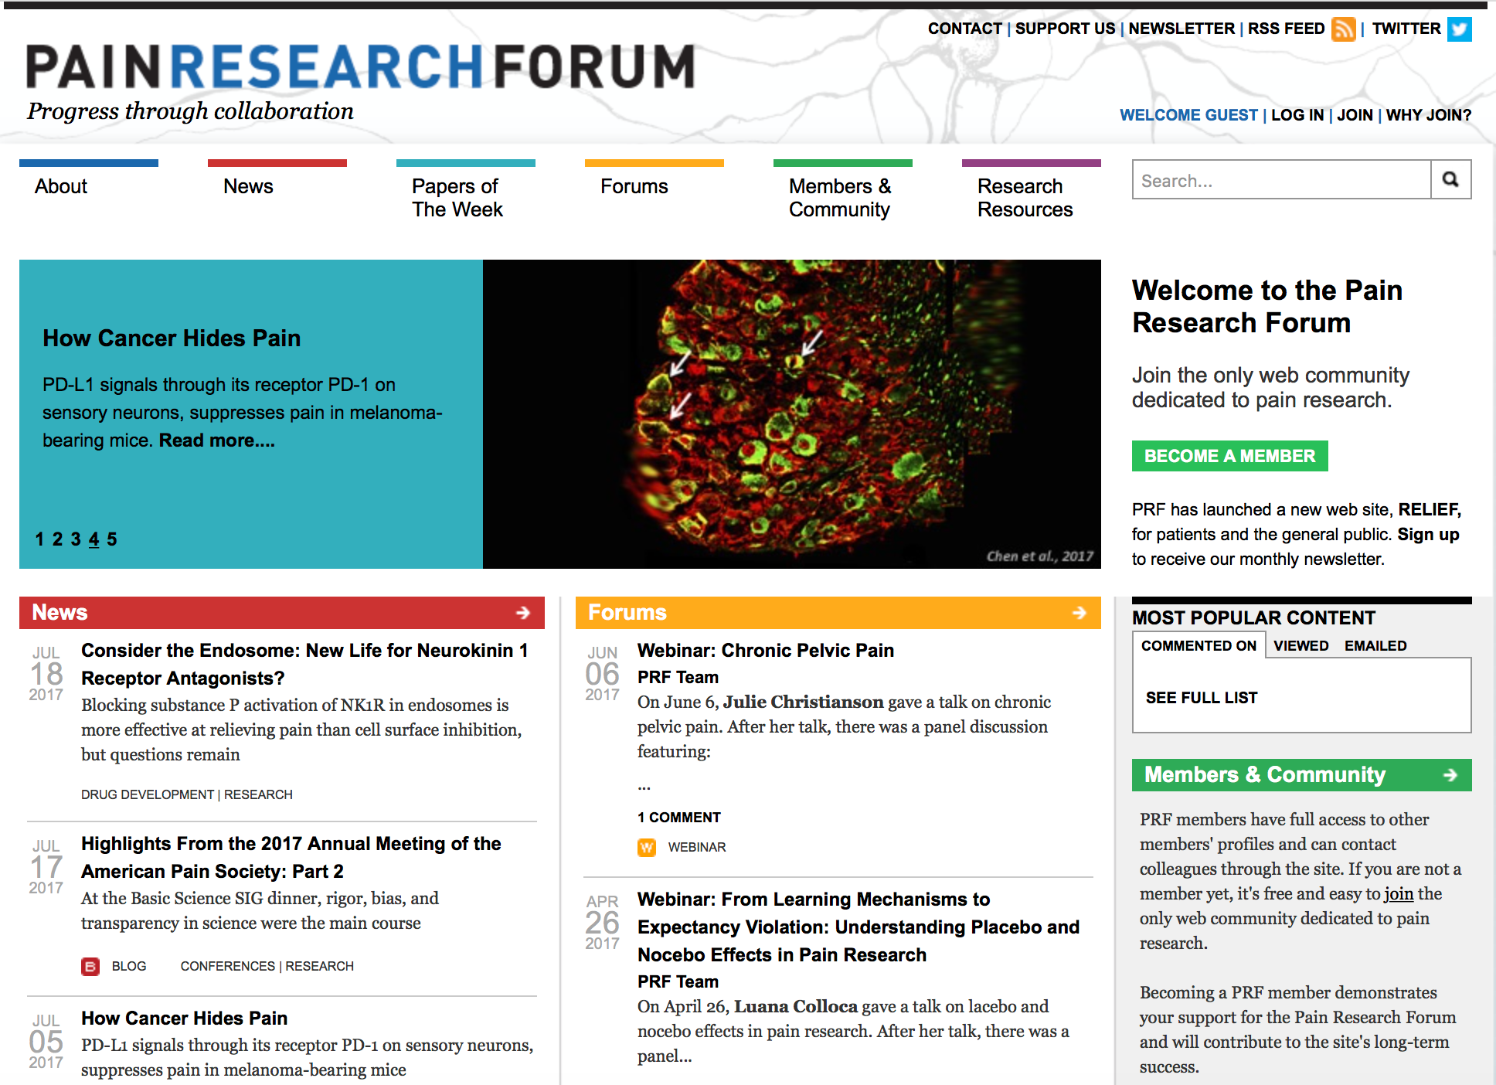
www.painresearchforum.org

Slide 7
Workshop Overview
Session 1: Epidemiology and Assessment of Pain
Session 2: Biopsychosocial Contributions
Session 3: Pain and Comorbidities
Session 4: Treatment of Pain
Session 5: Social & Behavioral Sciences

Slide 8
Housekeeping
Please silence cell phones
2-3 Speakers per session, followed by Panel Discussion
Breaks mid-morning, lunch & mid-afternoon
Evaluation forms

Slide 9
Prevalence and Costs of Several Chronic Diseases in the United States
Point Prevalence (in millions)
2010 Annual Costs (in billions)

Slide 10
Pain and Disability
Low back pain is the leading cause of disability worldwide (Hoy et al, 2014)
3 of the 5 leading causes of disability are chronic pain conditions (US Burden of Disease Collaborators, 2013)

Slide 11
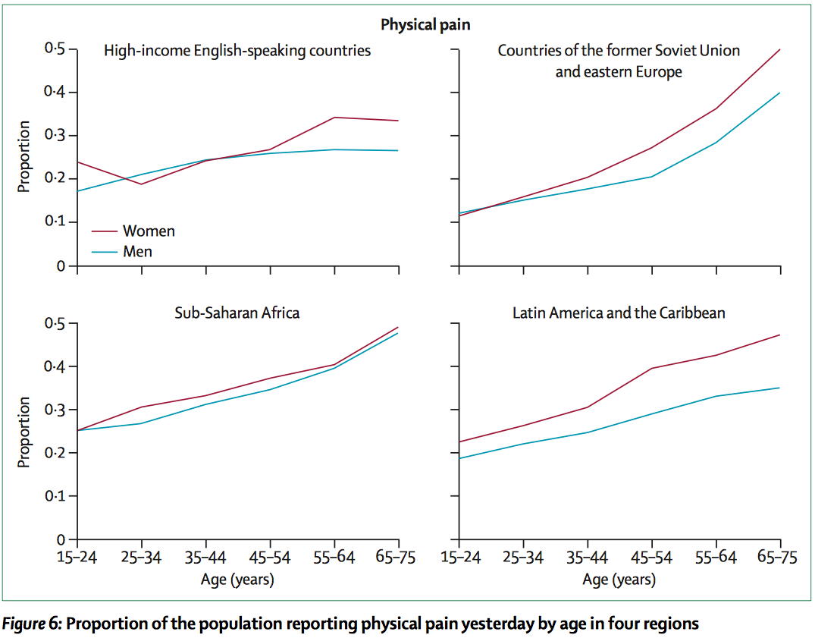
From the Gallup World Poll (2006-2010) – a survey of ~1,000 people in each of 160 countries worldwide

Slide 12
Overall Pattern of Age-Related Pain Prevalence
Joint pain (e.g. knee/hip OA), leg pain, foot pain
General chronic pain
Prevalence
Headache, abdominal pain, back pain, chest pain
Age
Fillingim, 2017, Pain 158 (Suppl 1):S11-18

Slide 13
Biological Factors
Disease severity
Nociception
Inflammation
Brain function
Psychological Factors
Mood/affect
Catastrophizing
Stress
Coping
Pain and Disability
Social Factors
Cultural factors
Social Environment
Economic factors
Social support

Slide 14
THANK YOU!

