Slide 3
Pharmacological Treatment of Pain in Older Adults
Assoc Prof Benny Katz
Director of Geriatric Medicine
St Vincent’s Hospital Melbourne, Australia
Benny.Katz@svha.org.au

Slide 4
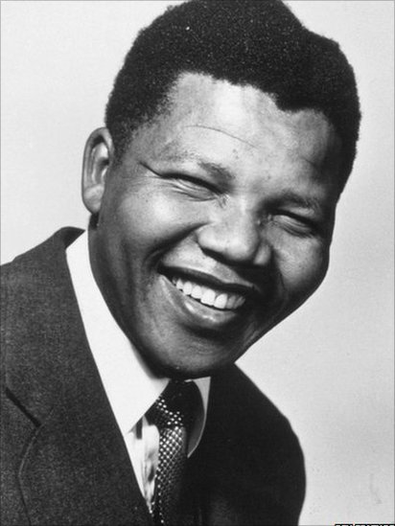
Nelson Mandela
1918 - 2013
Notes:
Ageing is a continuum. Mandela lived 95 years
Mandela lived three decades in the period we typically consider as old age. His needs changed through this period.

Slide 5
curative intent
pain
treatment guidelines
- evidence base
- expert opinion
physiological changes
patient preference
the patient
functional status
resources
comorbidities
frailty
polypharmacy

Slide 6
Nelson Mandela
1918 - 2013
Disease prevention
Cure
Disease control
Symptom control
End-of-life care
Notes:
Ageing is a continum
Mandela lived 95 years
During this time therapeutic objectives changed

Slide 7
Nelson Mandela
1918 - 2013
Disease prevention
Cure
Disease control
Symptom control
End-of-life care
Age related physiological changes
Co-morbid conditions
Polypharmacy
Function
Frailty
Notes:
Ageing is a continum
Mandela lived 95 years
During this time therapeutic objectives changed

Slide 8
Prevalence of pain in specific sites, by age group National Health and Aging Trends Study 2011. United States. N = 7601
Bothersome pain in the last month
years
Adapted from Patel KV et al. Pain 2013;154 2649–57.
Notes:
The study sought to determine the prevalence and impact of pain in a nationally representative sample of older adults in the United States (US). Data from the 2011 National Health and Aging Trends Study were analyzed. In-person interviews were conducted in 7,601 adults ages ≥65 years. The response rate was 71.0% and all analyses were weighted to account for the sampling design. The overall prevalence of bothersome pain in the last month was 52.9%, afflicting 18.7 million older adults in the US. Pain did not vary across age groups (P=0.21) and this pattern remained unchanged when accounting for cognitive performance, dementia, proxy-responses, and residential care living status. Pain prevalence was higher in women and in older adults with obesity, musculoskeletal conditions, and depressive symptoms (P<0.001). The majority (74.9%) of older adults with pain endorsed multiple sites of pain. Several measures of physical capacity, including grip strength and lower extremity physical performance, were associated with pain and multisite pain. For example, self-reported inability to walk 3 blocks was 72% higher in participants with than without pain [adjusted Prevalence Ratio=1.72 (95% Confidence Interval: 1.56–1.90)]. Participants with 1, 2, 3, and >4 sites of pain had gait speeds that were 0.01, 0.03, 0.05, and 0.08 meters per second slower, respectively, than older adults without pain, adjusting for disease burden and other confounders (P<0.001). In summary, bothersome pain in the last month was reported by half of the older adult population of the US in 2011 and was strongly associated with decreased physical function.

Slide 9
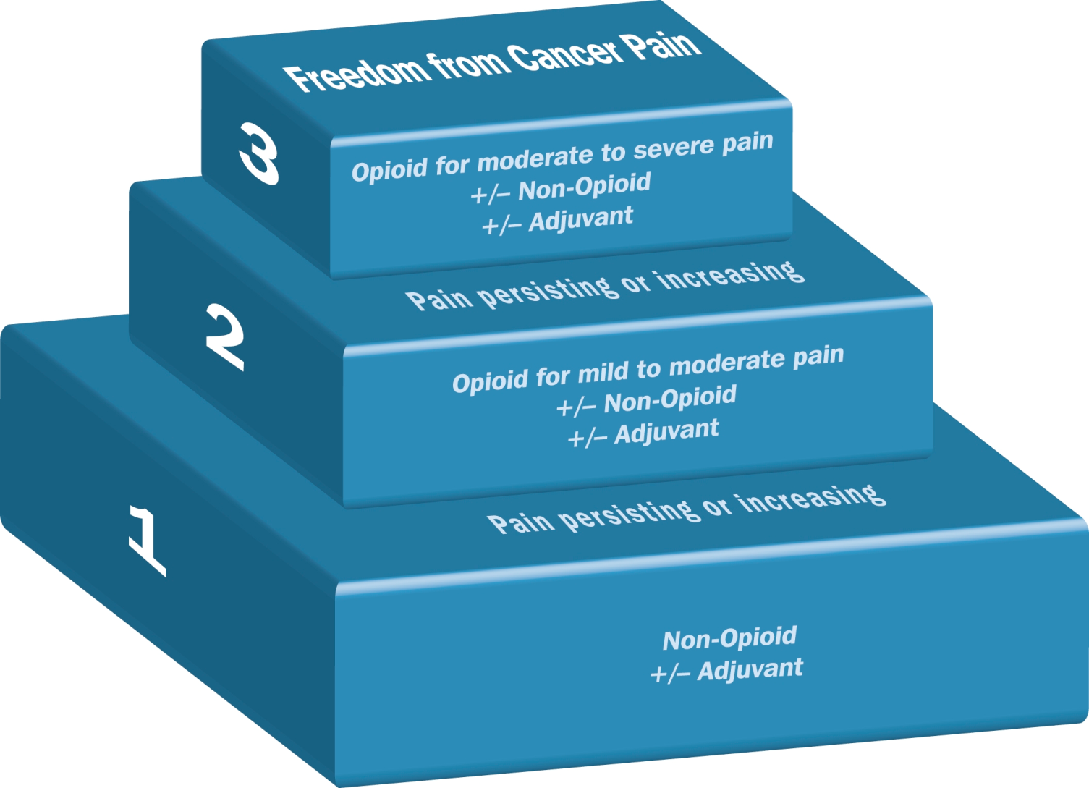
historical perspective
American Geriatrics Society guidelines 2009
British Geriatrics Society 2013
Acetaminophen/paracetamol is an effective agent for the management of osteoarthritis and low back pain
In properly selected and monitored patients, opioid analgesics offer a potentially effective, and for some patients indispensable treatment
Opioids may be associated with less risk than NSAIDs in older people
WHO 1986 for management of cancer related pain
Adapted for acute and chronic non-cancer pains
JAGS 2019;57:1131-46
Age and Ageing 2013;42:i1-i57
http://www.cancerworld.org

Slide 10
Paracetamol (acetominophen) | First line treatment Generally safe in standard doses | Reduce maximum dose with hepatic dysfunction, low body mass, alcohol abuse
NSAIDs and Coxibs | Use with great caution Lowest dose, shortest duration | Upper GI toxicity, renal dysfunction, hypertension, cardiovascular events. avoid Coxibs with heart disease naproxen has lower CV risk Consider PPI
Opioid analgesics | Moderate to severe persistent pain not responsive to non-opioid analgesia | Withdraw if ADRs or therapeutic goals not achieved. Avoid methadone
Adjuvant analgesics | Neuropathic pain eg (PHN, diabetic neuropathy, post stroke central pain syndrome). Fibromyalgia | Avoid tricyclic antidepressants

Slide 11
analgesic use in frail community dwelling older people
Random population sample
Kuopio, Finland
N = 605
Age >75 years
Koponen MPH et al. Drugs Aging 2013;30:219-136

Slide 12
paracetamol (acetaminophen)
Discovered 1877
WHO essential medicine
Most commonly used analgesic
Generally safe in standard doses
Meta-analysis of 13 RCTs
High quality evidence that:
Low back pain – no benefit
Hip and knee osteoarthritis – small effect on pain (<4 /100), probably not clinically meaningful
Machado GC et al. BMJ 2014;350:h1225
Notes:
Most widely used drug in the world
Relatively safe at recommended doses, even in frail older people
The question is of its efficacy

Slide 13
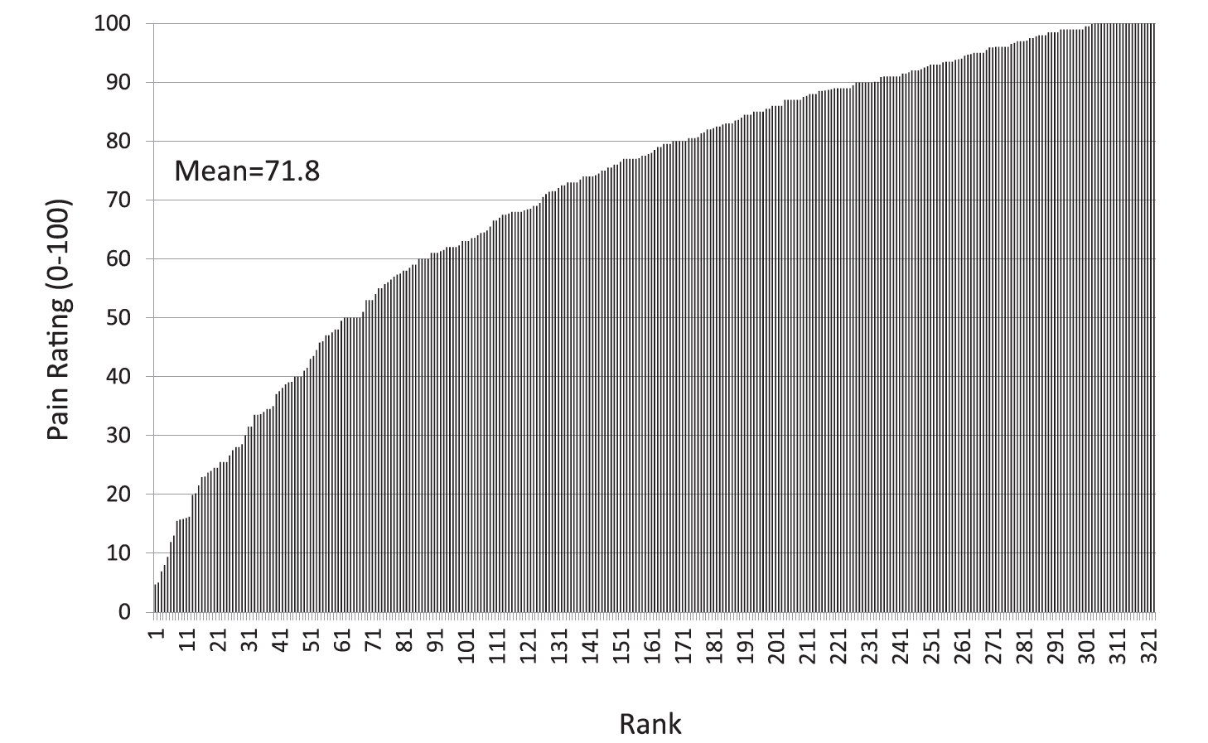
The individual may not respond in the same manner as the average subject in trials
Pain ratings in response to a heat stimulus (48°C) by 321 healthy young adults.
Fibromyalgia: individual response to pregabalin
Pre and post dose VAS scores.
Fillingim RB. PAIN 158 (2017) S11–S18
Moore RA. PAIN 2013;154: S77–S86

Slide 14
Non-steroidal anti-inflammatory drugs
No primary studies of NSAIDs or coxibs older people
NSAIDs implicated in ~1/4 hospital admissions due to adverse drug reactions in older people
GI toxicity (bleeding, ulceration) increases with age and dose
Renal effects especially when administered with ACE inhibitors and diuretics
Ischaemic heart disease - avoid coxibs
If used, NSAIDs should be used in the lowest dose for shortest possible period
Abdulla A et al. Age and Ageing 2013;42:i1-i57

Slide 15
NSAIDs and coxibs
Meta-analysis. 280 trials of NSAID vs placebo 124,513 participants
RR (95% CI)
 | All cause mortality | Major Vascular event | Upper GI complications
Coxibs | 1.22 (1.04 - 1.44) | 1.37 (1.14 - 1.66) | 1.81 (1.17 - 2.81)
Diclofenac | 1.20 (0.94 - 1.54) | 1.41 (1.12 - 1.78) | 1.89 (1.16 - 3.09)
Ibuprofen | 1.61 (0.90 - 2.88) | 1.44 (0.89 - 2.33) | 3.97 (2.22 - 7.10)
Naproxen | 1.03 (0.71 - 1.49) | 0.93 (0.69 - 1.27) | 4.22 (2.71 - 6.56)
CNT collaboration. Lancet 2013; 382: 769-97

Slide 16
NSAIDs for osteoarthritis of hip and knee
Network meta-analysis. 76 RCTs. N = 58,451
Paracetamol has no role as a single agent for osteoarthritis
Diclofenac 150mg/day is the most effective NSAID
Results may not be generalisable to older people
Mean age in studies 60’s. Only 2 studies was the mean age >70
Most studies less than 3 months
doses may not be tolerated by older people
Safety considerations
da Costa et al. Lancet 2017;309:e23-33D
Notes:
Lancet July 8 2017

Slide 17
Bally M et al. BMJ 2017;357:j1909

Slide 18
NSAIDs: Risk of acute myocardial infarction
Bally M et al. BMJ 2017;357:j1909

Slide 19
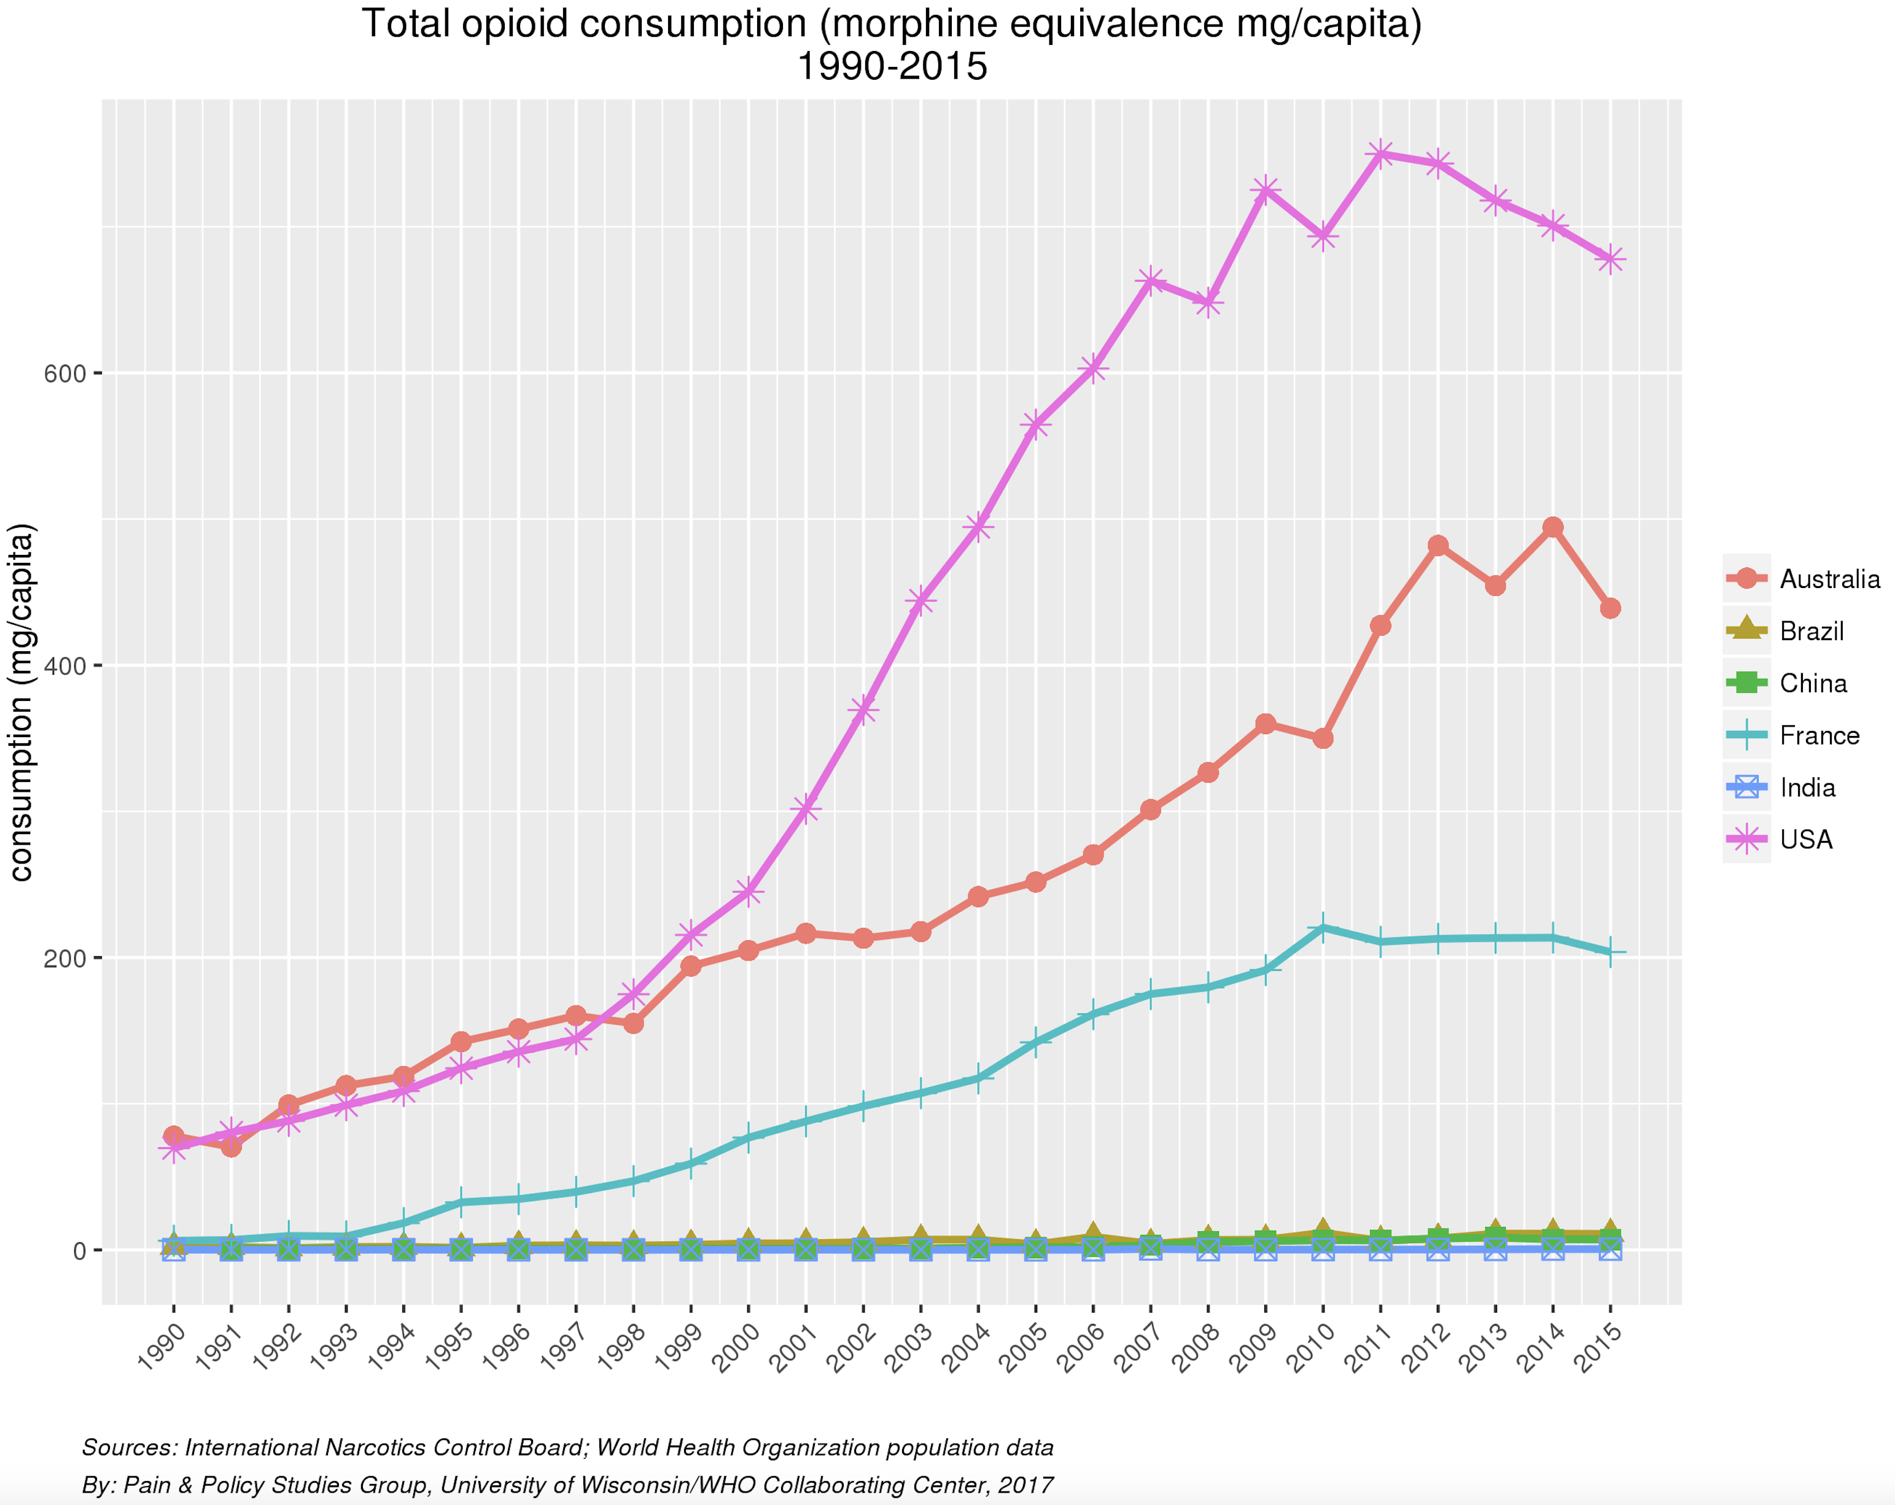
Total opioid consumption (morphine equivalence) 1990 - 2015
https://ppsg-chart.medicine.wisc.edu

Slide 20
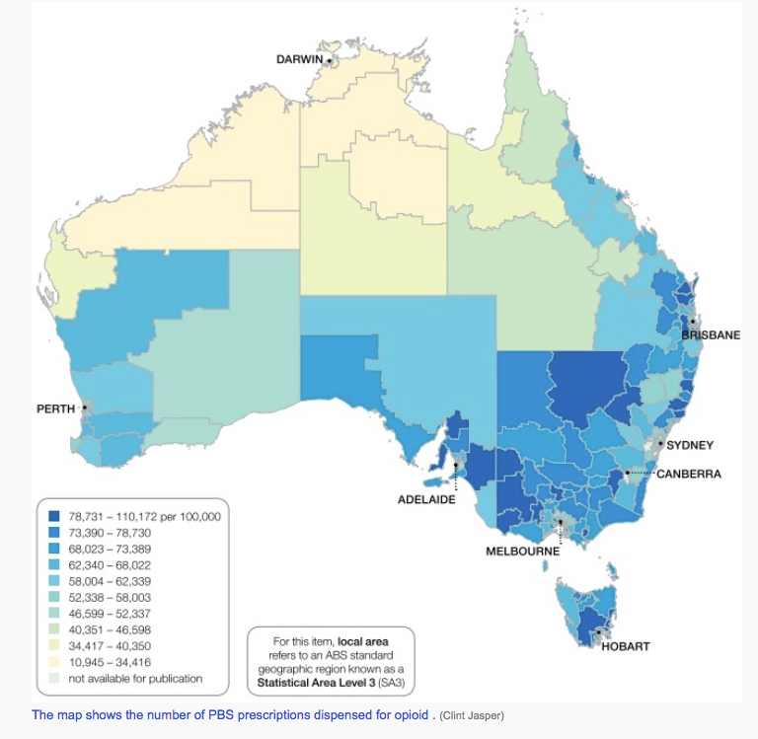
Regional variations in opioid prescribing
Morphine equivalents of opioids
prescribed in USA in 2015 by county
Opioid prescriptions in Australia
by LGA in 2013-14
Guy GP et al.
MMWR Morb Mortal Wkly Rep. 2017;66(26):697-704.
Australian Commission on Safety and Quality in Healthcare. Atlas of Healthcare Variation
https://www.safetyandquality.gov.au
Notes:
The amount of opioids prescribed in the United States peaked in 2010 and then decreased each year through 2015. Despite reductions, the amount of opioids prescribed remains approximately three times as high as in 1999.
The substantial variation in opioid prescribing observed at the county-level suggests inconsistent practice patterns and a lack of consensus about appropriate opioid use and demonstrates the need for better application of guidance and standards around opioid prescribing practices.
USA 5% worlsd population consumes 80% opioids

Slide 21
Oxycodone prescriptions in Australia by age group 2002 – 2008
A Roxburgh et al. MJA 2011; 195 (5): 280-284
Notes:
MJA 2011; 195 (5): 280-284 Abstract Objective: To document trends in: (i) prescribing of morphine and oxycodone; (ii) hospital separations for overdose; (iii) presentations for treatment of problems associated with these drugs; and (iv) oxycodone-related mortality data in Australia.
Design and setting: Cross-sectional study analysing prescriptions for morphine and oxycodone based on figures adjusted using Australian Bureau of Statistics estimated resident population and prospectively collected data from: (i) the National Hospital Morbidity Database on hospital separations primarily attributed to poisoning with opioids other than heroin (“other opioids”); (ii) the Alcohol and Other Drug Treatment National Minimum Data Set for treatment episodes where morphine or oxycodone were the primary or other drugs of concern; (iii) the National Coronial Information System on deaths where oxycodone was the underlying cause of death or a contributory factor.
Main outcome measures: Population-adjusted numbers of (i) prescriptions for morphine and oxycodone by 10-year age group, (ii) hospital separations for “other opioid” poisoning, and (iii) treatment episodes related to morphine or oxycodone; and (iv) number of oxycodone-related deaths.
Results: Prescriptions for morphine declined, while those for oxycodone increased. Prescriptions for both were highest among older Australians. Hospital separations for “other opioid” poisoning doubled between the financial years 2005–06 and 2006–07. Treatment episodes for morphine remained stable, while those for oxycodone increased. There were 465 oxycodone-related deaths recorded during 2001–2009.
Conclusions: Oxycodone prescriptions in Australia have increased, particularly among older Australians. The increase may, in part, reflect appropriate prescribing for pain among an ageing population. However we are unable to differentiate non-medical use from appropriate prescribing from this data. In comparison to heroin, the morbidity and mortality associated with oxycodone is relatively low in Australia. There is a continued need for comprehensive training of general practitioners in assessing patients with chronic non-malignant pain and prescribing of opioids for these patients, to minimise the potential for harms associated with use of these medications.

Slide 22
Opioids for chronic pain
Good short term efficacy in both neuropathic and musculoskeletal pain.
Average pain reduction with long-term opioid therapy ~32%.
No controlled study on opioid efficacy longer than 16 weeks
No evidence beyond 6 months.
Only 44% remained on treatment for 7 to 24 months
Daily doses of Morphine >180mg, or equivalent, have not been validated
80% of patients experienced at least one adverse event
Balantyne JC, Mao J. N Engl J Med. 2003:349;1943-1953 Turk DC. Clin J Pain. 2002;18:355-365 Lalso E. Edwards JE. Moore RA. McQuay HJ. Pain 2004; 112: 372-80

Slide 23
Opioid induced hyperalgesia
A state of nociceptive sensitisation caused by exposure to opioids, leading to a paradoxical sensitisation to non-noxious stimuli
Implications include increased acute pain during surgical procedures, and escalating opioid doses for chronic pain
Tolerance is characterised by reduced response that can be overcome by dose increase, whereas OIH may not respond to opioid dose increase that may worsen the pain
Lee M et al, Pain Physician 2011;14: 145-61

Slide 24
Falls and fractures by analgesic group for treatment of osteoarthritis
Risk of falls and fractures higher with opioid analgesia than with
COX-2 inhibitors
OR = 3.3, 95% CI = 2.5–4.3
or
NSAID
OR = 4.1, 95% CI = 3.7–4.5
Pennsylvania 2001–09
electronic medical records
N = 13,354, aged 65 to 89, diagnosis of OA
Rolita L et al. JAGS 2013; 61:335–340
Notes:
JAGS 61:335–340, 2013

Slide 25
Risk of fracture among current opioid users
Hip fracture
similar results for hip, humerus, or wrist fractures
strongest fracture risk with first prescription
fracture risk decreased with increasing use
UK GP research database.
1990–2008
N = 21,739 fracture cases,
85,326 matched controls
Li L et al, American Journal of Epidemiology, 2013
DOI: 10.1093/aje/kwt013
Notes:
United Kingdom– General Practice Research Database, 1990–2008

Slide 26
risk of fracture among current opioid users stratified by age
aged 18–60 years
61–70 years
71–80 years
Female data displayed
No age or gender effect
Li L et al, American Journal of Epidemiology, 2013
DOI: 10.1093/aje/kwt013

Slide 27
fracture risk by opioid type
Hip Fracture
Similar results for each opioid type except morphine for hip, humerus, or wrist fractures
UK GP research database.
1990–2008
N = 21,739 fracture cases,
85,326 matched controls
Li L et al, American Journal of Epidemiology, 2013
DOI: 10.1093/aje/kwt013
Notes:
The odds ratios were adjusted for smoking, body mass index (weight (kg)/height (m)2 ), number of general practice visits, recorded years before index date, opioid use (new vs. prevalent), comorbidities (including osteoporosis, osteoarthritis, rheumatoid arthritis, fibromyalgia, Parkinson disease, multiple sclerosis, chronic obstructive pulmonary disease, ischemic heart disease, congestive heart failure, stroke, and cataract), comedications (including antiosteoporosis drugs, steroids, hormone replacement therapy, antidepressants, antiepileptics, hypnotics and anxiolytics, acetaminophen, antihypertensive drugs, and calcium), types of pain (including headache, joint pain, and other musculoskeletal pain), and recent/past opioid use in addition to matching variables. Bars, confidence interval.

Slide 28
opioid prescriptions and prescription opioid related deaths
United States 1999-2013
Australia 2001-2011
(oxycodone)
Renthal W. JAMA Neurology 2016; 73:513-4
Pilgrim JL et al
Forensic Sci Med Pathol (2015) 11:3–12

Slide 29
Opioid pain reliever and benzodiazepine related deaths. USA 2010
CDC. Morbidity and Mortality
Weekly Report October 10, 2014
www.cdc.gov
Notes:
https://www.cdc.gov/mmwr/pdf/wk/mm6340.pdf

Slide 30
Deaths in Victoria, Australia
Coroners Court of Victoria

Slide 31
CDC Guideline for Prescribing Opioids for Chronic Pain in the United States, 2016.
Non-pharmacological and non-opioid therapy is recommended for CNMP
Before initiating therapy, negotiate treatment goals with the patient, and an agreement to discontinue if not achieved.
Risks and benefits should be discussed with the patient
For chronic pain commence with immediate release opioids, not long acting opioid.
Use lowest effective dose. Reassess risk and benefit at 50mg morphine equivalent. Avoid >90mg ME
For acute pain, prescribe lowest effective dose for shortest possible period. Usually 3 days is adequate, rarely 7 days.
For chronic pain, reassess the risks and benefits within 1 – 4 weeks, then 3 monthly
Evaluate the risk before starting opioids, then periodically. Employ strategies to mitigate risk, esp in older people, history of OD, high dose or concomitant use of benzodiazepines
Comply with local regulations
Consider urine testing
Avoid concurrent prescriptions of opioids and benzodiazepines
Use evidence based treatments for opioid use disorder
JAMA 2016;315:1624-1645

Slide 32
NeuPSIG guideline pharmacotherapy for neuropathic pain
Meta-analysis of 229 studies
Pharmacotherapy for neuropathic pain
1st line treatment (strong evidence) | gabapentin/pregabalin | SNRIs – duloxetine or venlafaxine | Tricyclic antidepressants
2nd line treatment (weak recommendations) | Tramadol | Capsaicin 8% patches | Lidocaine 5% patches
3rd line treatment | Strong opioids | Botulinum toxin B
X
X
Finnerup B et al. Lancet Neurol 2015;162-73

Slide 33
prescriptions for neuropathic pain medications Pharmaceutical Benefits Scheme (Australia) 2012- 2015
Pregabalin
Amitriptyline
Duloxetine
Carbemazepine
Gabapentin
www.pbs.gov.au 2015
Notes:
https://www.pbs.gov.au/industry/listing/participants/public-release-docs/10-2015/pregabalin-24month-analysis-dusc-prd-10-2015-final.pdf

Slide 34
prescriptions for pregabalin in Australia by age Pharmaceutical Benefits Scheme
Mean age of study participants.
Moore RA.
Cochrane Library 2009
www.pbs.gov.au 2015
Notes:
https://www.pbs.gov.au/industry/listing/participants/public-release-docs/10-2015/pregabalin-24month-analysis-dusc-prd-10-2015-final.pdf

Slide 35
number needed to treat to achieve 50% pain reduction
Finnerup B et al. Lancet Neurol 2015;162-73

Slide 36
bimodal distribution of pain response
Naproxen for osteoarthritis
Duloxetine for painful diabetic neuropathy
R. Andrew Moore. PAIN 2013;154: S77–S86

Slide 37
bimodal distribution of pain response
Naproxen for osteoarthritis
Duloxetine for painful diabetic neuropathy
Response is <30%
It is more likely to be a placebo response than therapeutic response
→ consider trial off treatment
R. Andrew Moore. PAIN 2013;154: S77–S86

Slide 38
bimodal distribution of pain response
Naproxen for osteoarthritis
Duloxetine for painful diabetic neuropathy
Response is >50%
It is more likely to be due to a therapeutic effect than placebo
R. Andrew Moore. PAIN 2013;154: S77–S86

Slide 39
the art of treatment of persistent pain in older adults
Paucity of evidence
Pharmacotherapies have limited efficacy
Increased risk of adverse treatment effects
Pharmacotherapies are best combined with non-pharmacological therapies
Negotiate treatment goals
Greater gains may be achieved in function than pain reduction
The risk-benefit may be acceptable if therapeutic goals are achieved
Discontinue treatments if inadequate response or intolerable side effects or risk

Slide 40
Case study
CD, 81F referred with 10 years of worsening back pain
L3/4/5 laminectomy 2012
C3/4 fusion 2009
Bilateral hip replacements 2006, 2009
Bilateral knee replacements 2004, 2006
SIJ radiofrequency denervations
Caudal epidural 2017
Buprenorphine patch, tapentadol, pregabalin, meloxicam

Slide 41
Case study
Buprenorphine patch 10mcg hour
Tramadol IR 100mg PRN (av 2/ week)
Pregabalin 150mg BD
Meloxicam (recently ceased)
Glucosamine
Irbesartin
Diltiazem
Metoprolol
Frusemide
Atorvastatin
Metformin
Sitagliptin
Esomeprazole
Temazepam
Vit D

Slide 42
Case study
Brief Pain Inventory
Worst pain 8/10
Least pain 3/10
Interference in general activity 5/10
interference in walking 8/10
Interference in enjoyment of life 8/10
Goals: to attend theatre, art galleries, travel
Is pain the only barrier?
“No, pain and fear of falling”

Slide 43
Case study
Physiotherapist: compared use of single point stick and 4 wheeled frame
Focus on goals, not simply her pain. Optimise balance and mobility
Encouraged to use 4 wheeled frame
Medications
↓ pregabalin
↓ temazepam
↓ meloxicam
Opioids

Slide 44
key points
The optimal approach to the management of chronic pain is a combination of pharmacological and non-pharmacological approaches
Patients often value autonomy over pain relief
Improvements in function may be greater than in pain scores
Discontinue ineffective or poorly tolerated treatments
Start low, go slow
Review
Discontinue treatments that have not achieved their goal

Slide 45
Thank you

