Slide 1
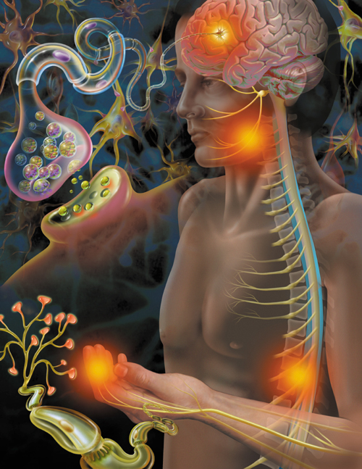
Sleep Disturbance and Chronic Pain in Older Adults
Michael T. Smith, Ph.D.
Professor of Psychiatry
Johns Hopkins University
School of Medicine,
Department of Psychiatry
07/23/17
msmith62@jhmi.edu

Slide 2
Conflict of Interest Disclosures (5 years)
X
The author wishes to disclose the following potential conflicts of interest:
Type of Potential Conflict | Details of Potential Conflict
Grant/Research Support | NIH: T32 NSO70201 , NIDA, R01DA0329922 NICDR R01 DE019731, NINR 1P30 NR014131 ; Merck
Consultant | FitBit, Inc.
Speakers’ Bureaus
Financial support
Other | Equity Stake: BMED Interactive
X
The material presented in this lecture has no relationship with any of these potential conflicts

Slide 3
Aims of the Lecture
Provide a brief overview of the longitudinal and experimental literature describing the sleep-pain relationship.
Discuss 2 promising mechanisms, associated with aging by which sleep disruption and / or sleep loss may induce hyperalgesia and increase risk for chronic pain
  Diminished Pain Inhibitory Capacity (CPM)
  Increased Inflammation
Discuss emerging literature demonstrating the potential benefits of cognitive-behavioral therapy for insomnia on sleep, pain and systemic inflammation in older adults with chronic pain.

Slide 4


Sleep & Chronic Pain Disorders are Highly Comorbid Health Epidemics among older adults
Restless Legs Syndrome 4-10%
(Edwards, Allen, Earley, Smith, 2011)
Circadian Rhythm d/o
?
?
Chronic Insomnia
10-20%
50% - 88%
Chronic Pain
11.5-55.2%
Beh. Induced insufficient sleep syndrome ?
39-75%
Webster et al. 2008
Sleep Apnea
4-20%
Gooneratne & Vitiello, Clin. Geriatr Med 2014

Slide 5
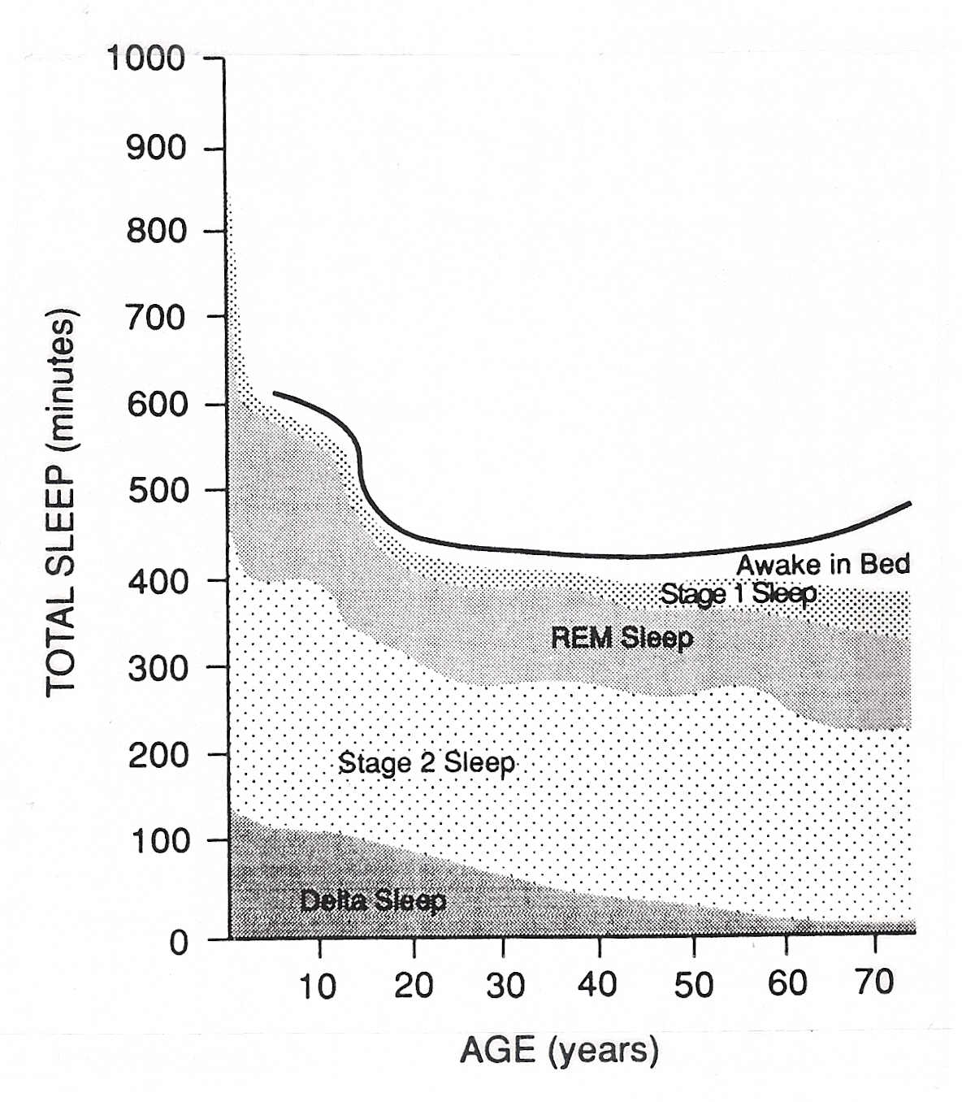
Sleep Architecture Across The Lifespan
Decline in SWS in late adolescence corresponds to developmental decrease in cortical synaptic density (dearborization, dendritic pruning)
Early Life
REM 
SWS 
TST 
Late Life
REM  slight
SWS 
Light Sleep 
Time awake in bed 
TST  more likely redistributed

Slide 6
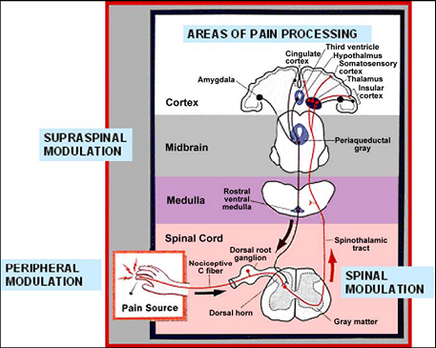
What is Chronic Pain?
Pain that persists beyond expected time of healing ? (3 mos ?)
Chronic Pain is ↑ conceptualized as a neurologic disorder [Melzack, R (1999)]
  Central Sensitization
  Dysregulation of supraspinal inhibitory & facilitatory mechanisms that modulate nociception & regulate spinal sensitization
  Sleep disturbance: may alter these descending systems (Smith et al. 2007)
DeLeo, 2006

Slide 7
What is the objective sleep profile of chronic pain patients?
Sleep continuity disruption is a robust and consistent finding
  Increased sleep latency
  Increased frank wake after sleep onset time; and arousals
  Decreased total sleep time
  Decreased sleep efficiency (total sleep time / time in bed)
Sleep architecture findings were more mixed, but most consistent finding was reduced slow wave sleep
Caveat: N=29; many had methodological flaws
  More objective descriptive work is needed with large sample sizes.

Slide 8
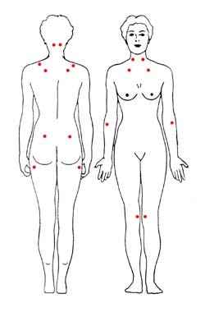
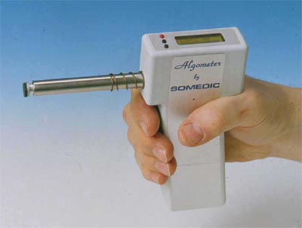
How Are Sleep and Pain Inter-related ?
1) Traditional Linear View
PAIN
AROUSAL
Sleep Disruption
2) Reciprocal View (Moldofsky, 1975)
Sleep deprivation causes:
Hyperalgesia
  Thermal sensitivity
  Mechanical sensitivity
Spontaneous pain (Haack, 2005, Smith 2007)
Lentz (1999); Onen (2001); Kundermann (2004); Roehrs, et al (2006); Kundermann (2008)

Slide 9
What do the longitudinal clinical data show ?
Diary Studies in chronic pain: relationship is bidirectional (Sleep Pain)
    Poor sleep associated with increased next day pain & vice versa (Affleck, 1996; Stone,1997; Smith, 2010)
    Sleep may be more robustly linked with next day pain than pain impacting next day sleep (Finan et. al. 2015)
    At least 5 prospective epidemiological studies controlling for psychosocial risk factors show that over 1-3 years poor sleep [Gupta (2007); Mikkelsson (1999); Bonvanie (2016); Sanders (2016); Harrison (2014)]
    Confers 2-3 fold risk of new onset chronic pain
    Linked to persistence and progression of emergent musculoskeletal pain
    Predicts progression from regional to widespread pain disorder
Restorative sleep linked to 3 fold remission rate from WP[Davies (2008)]
Insomnia Increases risk of chronic pain after acute injury
[Castillo (2006)]; Smith et. al. (2008)

Slide 10

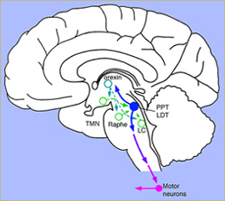
What are the Mechanisms of Sleep Disturbance
Induced Hyperalgesia?
Sleep and pain systems share many overlapping neurobiologic substrates
Does sleep disturbance alter descending pain modulatory systems associated with central sensitization and if so… at what level of the neuroaxis?
DeLeo, 2006

Slide 11

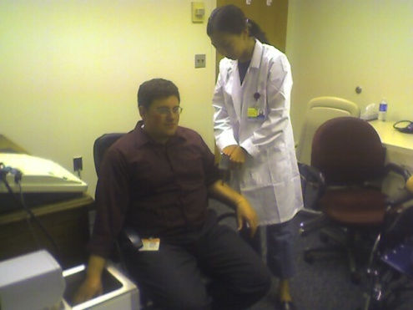
Higher Order Measures of Pain Inhibition
Conditioned Pain Modulation (aka DNIC)
    “Pain inhibits pain”
    Simultaneous application of 2 noxious stimuli
      Phasic (Pressure Pain Threshold—algometry)
      Conditioning stimulus administered at distant site
        Cold pressor task: 45 secs (contra lateral side)
    ↑ Pain threshold (↓ pain sensitivity) during tonic painful stimulus from baseline
    Supraspinally mediated inhibition of wide dynamic range neurons in dorsal horn (LeBars, 1992)
      Cervical transection studies
    Meditated by endogenous opioids ? (blocked by naloxone)
        Willer, 1990; Julien N, 2006; Anderson; 2002
        Not simply distraction—thalamic lesion (Broucker, 1990)

Slide 12
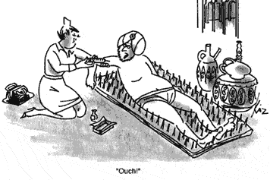
Impaired CPM Is Associated with Several Chronic Pain Disorders
Fibromyalgia
  Luatenbacher,1997
  Kosek & Hansson,1997
  Staud, Pain (2003)
Temporomandibular J / D
  Maixner, 1995
  Kashima, 1999
Irritable Bowel Syndrome
  Wilder-Smith, 2004
Low Back Pain
  Peters et al., 1992
Tension headache
  Pielsticker, 2005
THE ABSENCE OF CPM

Slide 13
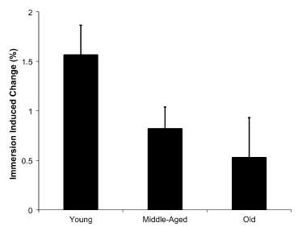
Quantitative Sensory Testing and Aging
Pain thresholds: Older adults have higher pain thresholds (less sensitive)
  e.g., Riley, JL et. al., JOP (2014)
Pain modulation: older adults demonstrate impaired Pain Modulation
  Reduced Pain Inhibitory Capacity
    [Conditioned Pain Modulation (CPM)]
      Riley, J et al. Pain (2012)
Reduced CPM by Age
Lareviere et al. (2007), clin. J Pain

Slide 14
Does Sleep Fragmentation and / or Sleep Restriction Alter CPM?
Insomnia Analogue (sleep continuity disturbance)
Forced Awakening Sample Timeline- 8 Hour Period
PM
AM
10:00-11:00
11:00-12:00
12:00-1:00
1:00-2:00
2:00-3:00
3:00-4:00
4:00-5:00
5:00-6:00
20
20
20
20
20
20
20
20
20
20
20
20
20
20
20
20
20
20
20
20
20
20
20
20
= 20 minute block of time during which participants are kept awake
Total Possible Sleep Time = 280 minutes
Smith et al., Sleep, 2008

Slide 15
Results: CPM (Pain Inhibition)
Sleep Fragmentation, But Not Sleep Restriction
Impairs Endogenous Pain Inhibitory Processes
+100
+80
§
§
§
+60
+40
% Change from Baseline in CPM Index♣
+20
Control
0
FA
-20
RSO
Replicated with Ischemic Pain Habituation; Iacovides et. al., JOP, 2017
-40
-60
-80
-100
Baseline
P1
P2
P3
Total
Recovery
Consecutive Days 3-8
Smith et al., Sleep, 2008
N = 32 Women (12,10,10)

Slide 16
Poor Sleep Subsequently Linked to Impaired Pain Inhibitory Capacity (CPM)
In Pain Disorders and in Primary Insomnia
Name | Disorder | N | Outcomes
1. Monica Haack (2011), Euro. Jo. of Pain | Primary Insomnia | 17 | Insomnia ⬇CPM compared to control
2. Edwards RR. (2009), Euro. Jo. of Pain | TMJ/D (chronic Jaw pain) | 53 | ⬇PSG Sleep Efficiency, ⬇CPM
3. Paul-Savoi E (2012), Open Rheumatology | Fibromyalgia | 89 | ⬇Sleep quality , ⬇CPM
4. Lee YC (2013), Arthritis & Rheum. | Rheumatoid Arthritis | 58 | ⬇Sleep quality , ⬇CPM
5. Petrov ME. (2015), Jo. of Pain | Knee Osteo-Arthritis | 137 | ⬆ Insomnia sev. (ISI), ⬇CPM, especially in Whites

Slide 17
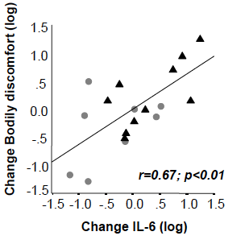
Inflammation: A Good Candidate Mechanism of Sleep Disruption Induced Hyperalgesia
Total and/or Partial Sleep Deprivation Enhances Inflammation:
      Circulating IL-6 (Vgontzas, 2004),
      Cellular level (PBMCs)
        Transcription (nfKB)
        Gene expression IL-6 & TNF
        Capacity to produce IL-6 & TNF (Irwin MR, (2006 & 2008)
Correlation Between Spontaneous Pain & IL-6 After Chronic Partial Sleep Deprivation [Haack Mullington, sleep (2007)]
Basic Science Work Demonstrates a Major Role for Inflammation in Peripheral & Central Sensitization (e.g., Milligan & Watkins, Nat Rev Neursci (2009)
Inflammation is linked in separate studies with Sleep, & Chronic Pain Disorders [e.g., Vgontzas (2003), RA & OA (Livshits et al. Arthrit & Rheum (2009)]

Slide 18
Effects of Insomnia & Knee Osteoarthritis (KOA) on
Pro-inflammatory Cytokine Profiles
Case Control Study (Quartana & Smith; Brain Beh & Immun, 2015)
Interleukin – 6 Reactivity to lab pain challenge in older adults:
with or without KOA Pain and with or with Insomnia (4 groups: KOA – GS, KOA-I, PI, GS Pain Free Controls)
Lab Heat and Cold Pressor Pain (45 mins)
KOA - Good Sleeper (n=21): BMI = 28.6 , Age = 65
KOA - Insomnia (n=35): BMI = 32.6 , Age = 59
Primary Insomnia (n=17) BMI = 27.0, Age = 57
Good Sleeper - Control (n=17) BMI = 26.2, Age = 57
IL-6 pg / ml (nlog)
Both OA groups exhibit overall increased IL-6 AUG-G, attenuated after controlling for BMI & age.
All groups exhibit sig. linear Increases in IL-6 after lab pain
Primary Insomnia exhibits significant increasing IL-6 slope relative to all other groups over 30-60 minutes post pain, controlling for BMI & AGE
NIH/R01 AR059410

Slide 19

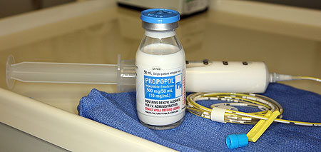

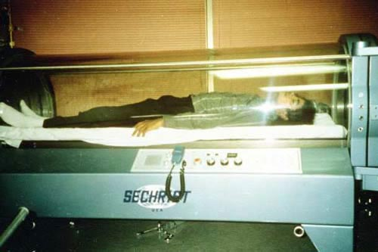
Clinical Implications / Issues
"Last week I probably slept an average of two hours a night.
"I couldn't stop thinking. My body was exhausted, and my mind was still going."

Slide 20
Assessment Issues: Medications
How do analgesic regimens promote or impede sleep quality?
Effects of Analgesic Drug Classes on Sleep Architecture
CLASS | NREM Sleep
 | NREM 1&2 | SWS | REM
Opioids | ↑ | ↓ | ↓
NSAIDs | - | ↓ | -
TCAs (e.g., amitriptyline) | Varies | ↑ | ↓
SNRI’s (e.g., duloxetine) | - | - | ↓
Anti-Convulsants (gabapentin) | ↓ Arousal (newer agents) | ↑ (newer agents) | -
Anti –Spasmotics (baclofen) | ↑ | - | ↑
Adequate nighttime analgesia is critical
**Consider effects of opioids on sleep & central apnea (Yue et al. Med. Clin N. AM, 2010)
Some anticonvulsants may be effective for insomnia [gabapentin (Lo et. al., 2010), pregabalin, Vinic
et al., 2013; Roth et. al 2010 ]
Cairnes, BE in Sleep & Pain (2007)

Slide 21
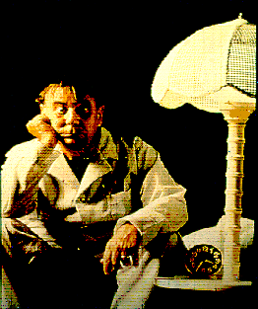
What is Insomnia?
Problem Initiating / Maintaining Sleep, or “Non-Restorative Sleep”
Difficulty occurs despite adequate opportunity for sleep
Impacts Daytime FX (fatigue, mood, Attn., energy, etc.)
General Criteria for Clinical Significance
Severity: Sleep latency, Middle of Night, or Early Morning Waketime >30 Mins.
Frequency: >3 night per week
Duration: >3 Month
Prevalence: 10-15% (chronic)
Differentially Impacts Women and Older Adults (20-40%)

Slide 22
CBT-I is a Recommended First
Line Treatment for Chronic Insomnia
American College of Physicians (Ann Intern Med. 2016)
    All Adult patients receive CBT-I as the initial treatment for chronic insomnia-Strong Recommendation
American Academy of Sleep Medicine Practice Parameters (Sleep, 2006); CBT-I is:
    “Standard” Treatment for chronic primary insomnia
Benzodiazepines and “Z” hypnotics are linked with falls and increased risk for hip fractures in older adults
    Donnelley, et al., PLOS One (2017)

Slide 23
Cognitive-Behavioral Treatment (CBT-I)
Targets Maintaining Factors
Data Driven
  Diaries / Actigraphy
  Chart weekly progress
Addresses Compliance
Individual or groups
Hyperarousal
Chronobiologic Dysregulation
Homeostatic Dysregulation
BEHAVIOR

Slide 24
Cognitive-Behavior Therapy for Insomnia: Multi-component Treatment Approach
COMMON COMPONENTS (not exhaustive)
Stimulus Control
Sleep Restriction
Sleep Hygiene
Relaxation therapy
Bright Light Therapy (Lack, 2007)
Cognitive Therapy
Overwhelming Empirical Support
Ineffective as a monotherapy
Not as effective as SRT and SCT [Morin et al., Sleep (2006)]
Notes:
Not clear that cognitive therapies alone are effective, developing area of research (Allison Harvey)

Slide 25
Comparative Meta-Analysis of
Behavior Therapy & Pharmacotherapy for Chronic Insomnia: Acute TX – N =21 Studies (470 subjects)
Overall Effect Size
Behavioral TX = .96
BZRAs = .87
*Sleep Latency Only Sig. Difference (p = .01)
*
Percent Improvement
Smith et al.
AJP, 2002
CBT-I Effective in Older Adults with Insomnia [ Meta-analysis; Irwin et al., Health Psychol. (2006)]

Slide 26
Clinical Trials of CBT-I in Chronic Pain
Name | Pain Type | N | Sleep Outcomes
1. Currie et al. (2000) | Mixed Pain | 60 | ↑ Sleep Continuity: Diary & Actigraphy, 3 Mo. FU
2. Edinger et al. (2005) | Fibromyalgia | 42 | ↑ Sleep Continuity: Diary & Actigraphy, 6 Mo. FU
3. Vitiello et al (2009) | Osteoarthritis | 51 | ↑ Sleep Continuity: Diary, 1YR FU
4. Jungquist et al. (2010) | Neck and Back | 28 | ↑ Sleep Continuity: Diary, FU data in preparation
Standard, multi-component CBT-I: SRT and SCT
Effect Sizes: Moderate to Large & comparable to CBT-I for PI
Outcomes maintained at follow-up (3 mos -1 Year)
CAVEATS
  No PSG outcomes
  All were attentional or waitlist control, No Double –blinded studies

Slide 27
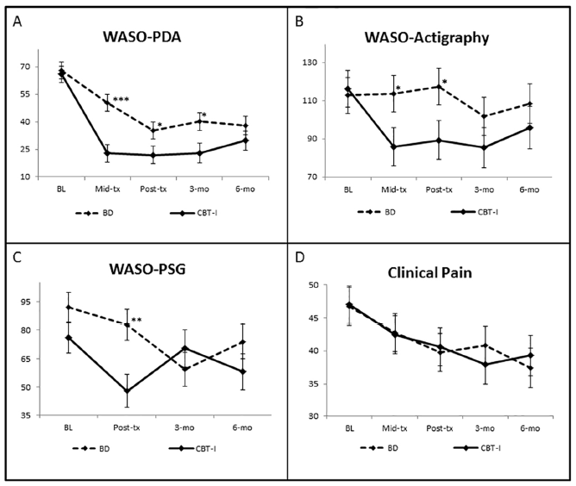
CBT-I in Knee Osteoarthritis
(Smith et al. (2015) Arthr. & Rheum)
A randomized, Double-blind, Active Placebo Controlled Trial
N = 100 KOA patients confirmed via knee radiographs
8 weeks CBT vs. 8 weeks behavioral desensitization
Full home ambulatory PSG measured at baseline, Post, 3, and 6 Mo
Patients with AHI >10 ruled out
  Sleep Findings
      Both groups demonstrated large improvements in sleep on most diary, actigraphy and PSG measures.
      CBT-I outperformed BD on WASO (primary outcome)
        Diary (M= -12 mins); P< .001
        Actigraphy (M= -14 mins); (p< .05)
        PSG (P =.08)
Notes:
27

Slide 28
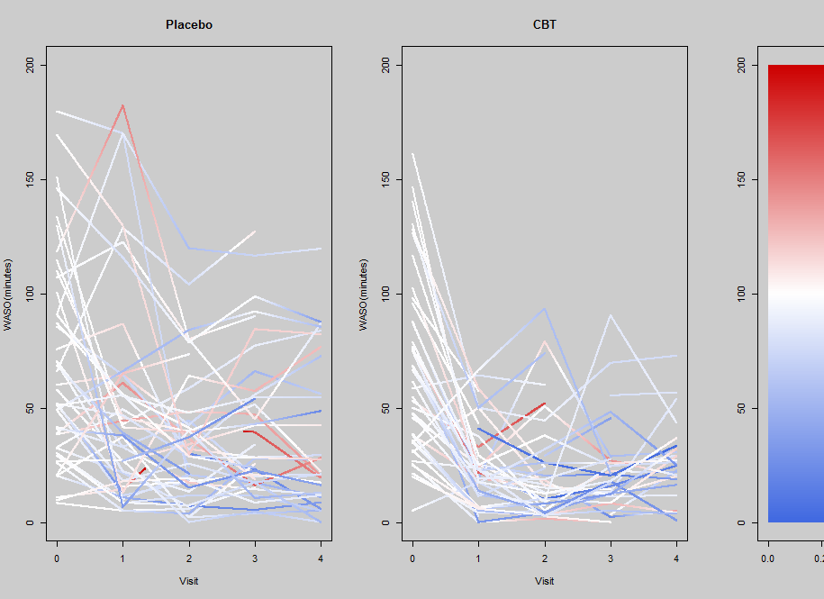
CBT-I Reduces Pain in Knee Osteoarthritis (N=100)
Smith et. al, Arthritis and Rheumatology, 2015 (NIH: R01 AR05487 )
33% achieved > 30 Reduction in Pain
Reductions in over 6 Mos pain were mediated by pre-post reductions in WASO
Behavioral Desensitization
CBT-I
100%
Pain Increase.
From BL
Wake After Sleep Onset Time
No Change
In Pain
100%
Pain Decrease.
From BL
BL
Mid.
Post.
3Mo.
6Mo.
BL
Mid.
Post.
3Mo.
6Mo.
Notes:
Here it is with ramped colors. I also ramped the color legend, as you can see.

Slide 29
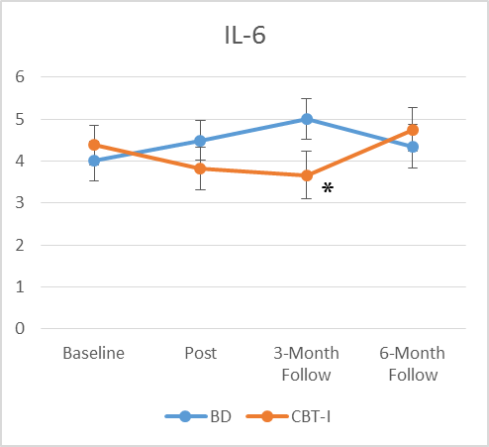
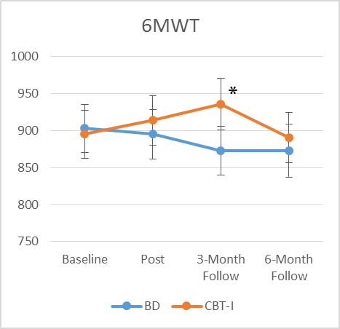
CBT-I Significantly Reduces Inflammation and Increases Physical Function (6MWT) over 3 Months, but not 6-Months (N= 73)
Manuscript in Prep; Speed
Proinflammatory Cytokine / IL-6
Distance Walked in 6 Minutes
†
B= .87,SE=.33; P= .01; d= .35;
Reductions in IL-6 associated with reduced WOMAC stiffness (r=.58**) and Actigraphy WASO r=.28)
B=-39.14,SE=.18.47; P= .038; d=.4
[Similar to Irwin et al.; Biol Psych (2015)]

Slide 30
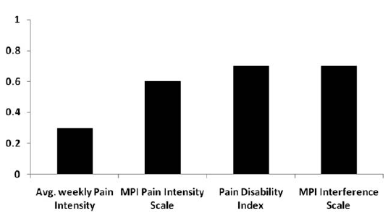
Other Preliminary studies of CBT-I on pain are promising but mixed.
Name | Pain Type | N | Pain Outcomes
1. Currie et al. (2000) | Mixed Pain | 60 | No: cohen’s d @ 3 mo’s = .41
2. Edinger et al. (2005) | Fibromyalgia | 42 | No, but Sort of (Sleep hygiene subgroup that spontaneously adopted SRT and SCT
3. Vitiello et al (2009) | Osteoarthritis | 51 | Yes (on some but not all measures)
4. Jungquist et al. (2010) | Neck and Back | 28 | Pain No, but Pain-related interference YES
Most of studies were not designed to answer this question
Effect Sizes of CBT-I on Pain are promising
Effect Sizes on Pain, Jungquist (2010)
Vitiello et al. 2013 & 14; McCurry et al (2014)

Slide 31
Take Home Messages
Sleep disorders and chronic pain are highly comorbid in older adults
Sleep disturbance causes hyperalgesia and is a major risk factor for chronic pain onset, severity and persistence.
Sleep loss impairs central pain modulation and heightens systemic inflammation--factors that are associated with aging, and age-related morbidity
Clinical issues implications:
  Have a low threshold for formal sleep disorders assessment for older adults with chronic pain and sleep complaints
  Aggressive treatment of underlying sleep problems is likely to improve pain control.
  CBT for insomnia is the first line treatment for insomnia in older adults.
    May decrease systemic inflammation
    May improve clinical pain

Slide 32



THANK YOU!
Johns Hopkins Behavioral Medicine Laboratory
  Jennifer Haythornthwaite, Ph.D.
  Robert Edwards, Ph.D.
  Luis Buenaver, Ph.D
  Claudia Campbell, Ph.D.
  Patrick Finan, Ph.D.
  Janelle Coughlin, Ph.D.
  Traci Speed, MD
  Jessiy Salwi, PhD
  Jim Fauerbauch, Ph.D.
Notes:
32

