Slide 1
The Translational Research Institute on Pain in Later Life (TRIPLL) at Cornell University
NIA funded Edward R. Roybal Center established in response to the plight of millions of older adults experiencing persistent pain.
Mission: To improve the prevention and management of pain in later life; thereby increasing the health and well-being of older adults.
Supports translational research on aging and pain in the greater NYC area.

Slide 2
How to get involved with TRIPLL
Join our email list and consider becoming an affiliate
Receive access to:
Monthly newsletter
Work-in-Progress seminars, webinars, funding, and conference announcements
Networking opportunities
Visit tripll.org or email Cara Kenien at cak2017@med.cornell.edu

Slide 3
Aging, Decision Making, and Pain Management: Webinar Series Introduction
Corinna E. Löckenhoff
Cornell University
Weill Cornell Medical College

Slide 4
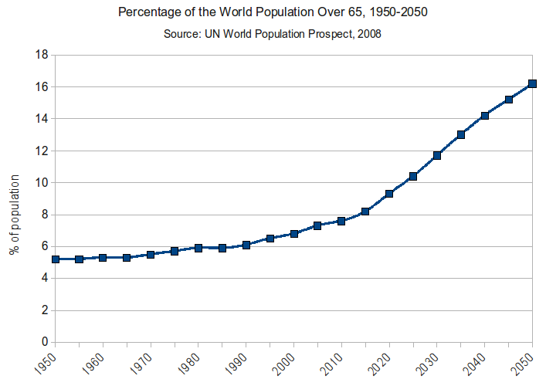
Population Aging
By Rcragun (Own work) [CC BY 3.0 (http://creativecommons.org/licenses/by/3.0)], via Wikimedia Commons

Slide 5
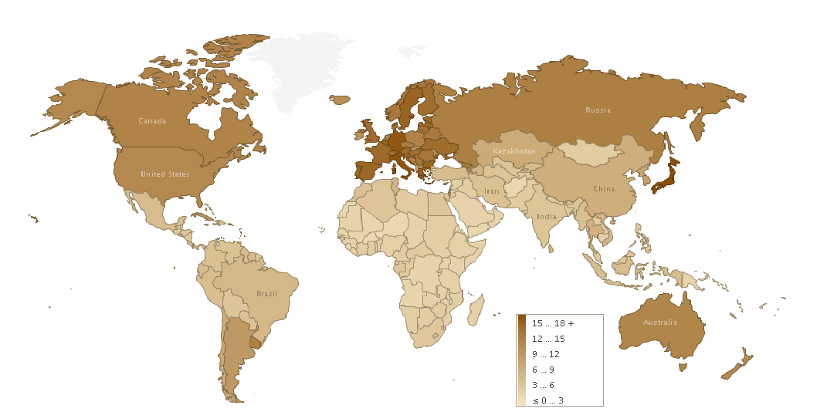
Population % Over Age 65
By Rcragun (Own work) [CC BY 3.0 (http://creativecommons.org/licenses/by/3.0)], via Wikimedia Commons

Slide 6
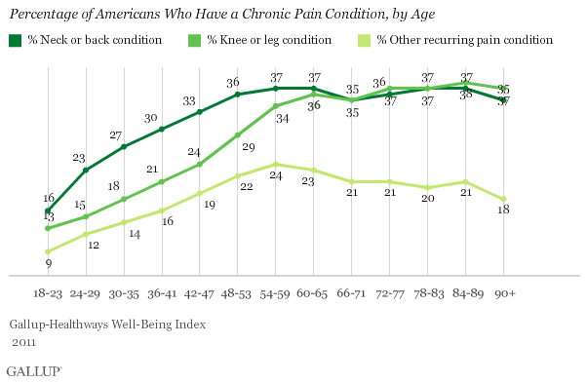

Slide 7
The Ideal of Informed Choice

Slide 8
Online Health Information

Slide 9
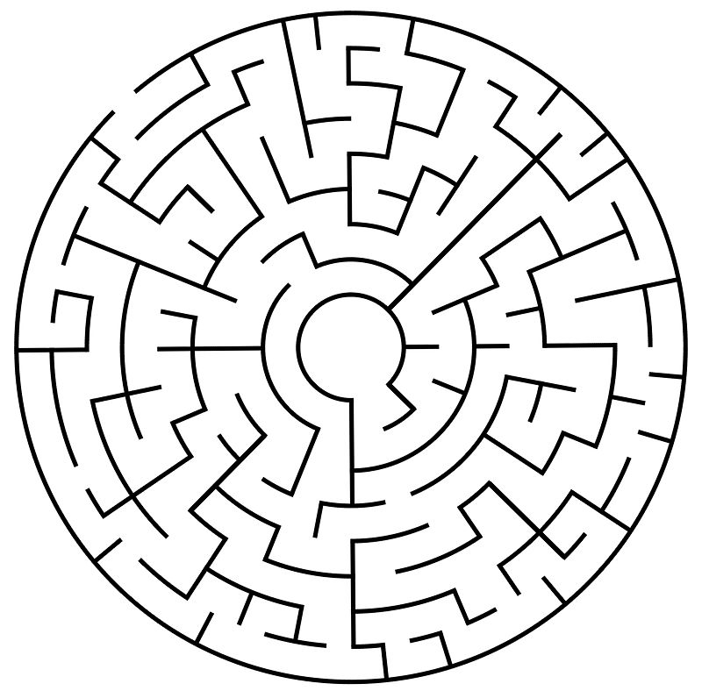
?

Slide 10
Today’s Talk
Misconceptions about decision making
Misconceptions about aging
Overview of age-related changes in decision making
Implications for pain management

Slide 11
Today’s Talk
Misconceptions about decision making
Misconceptions about aging
Overview of age-related changes in decision making
Implications for pain management

Slide 12
Decision Making in Isolation
Should I stay …
… or should I go?

Slide 13
Decision Making in Context
Context
Should I stay …
… or should I go?
Life Goals
Education
Societal
Norms
Social
Partners
Prior Knowledge
Co-Morbitities
Financial
Constraints

Slide 14
Decision Making as a Single Point in Time
Should I stay …
… or should I go?

Slide 15
Decision Making as a Process
Need Definition/
Problem Recognition
Information Search
Information Evaluation/
Strategy Selection
Should I stay …
… or should I go?
Outcome Evaluation

Slide 16
Decision Making as a Process
Need Definition/
Problem Recognition
Information Search
Information Evaluation/
Strategy Selection
Should I stay …
… or should I go?
Outcome Evaluation

Slide 17
Decision Making as Cognition
X2
X1
… or should I go?
X5
X4
X3
Should I stay …

Slide 18
The Role of Emotion
Incidental affect Current mood states (irrelevant to the decision)
Integral affect Emotional responses to decision options
Trade-off aversion Emotional responses to decision process

Slide 19
Decision Making
… happens in context
… constitutes a process
… involves both cognition and emotion

Slide 20
Today’s Talk
Misconceptions about decision making
Misconceptions about aging
Overview of age-related changes in decision making
Implications for pain management

Slide 21
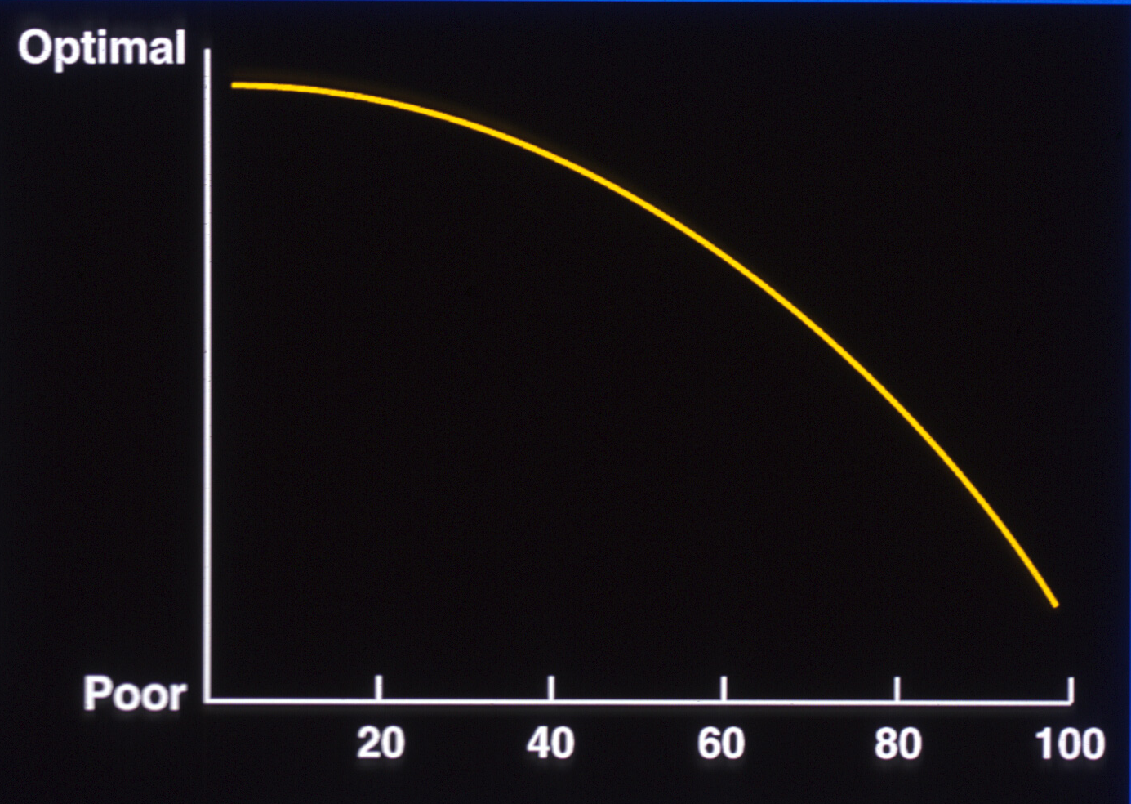
How we tend to think aging looks like …

Slide 22
How aging actually looks like …
Gerstorf & Ram, 2013

Slide 23
Healthy Aging vs. Terminal Decline
Gerstorf & Ram, 2013

Slide 24
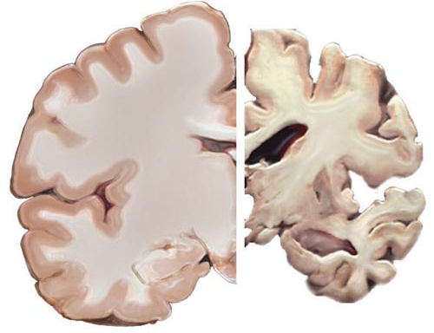
Emphasis on Cognitive Aging

Slide 25
Aging is Multidimensional

Slide 26
Aging is Multidimensional
Cognition
Goals and emotions
Time horizons
Cohort effects
Aging stereotypes

Slide 27
Aging is Multidimensional
Cognition
Goals and emotions
Time horizons
Cohort effects
Aging stereotypes

Slide 28
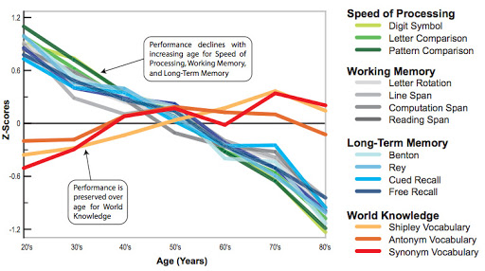
Cognitive Mechanics vs. Cognitive Pragmatics

Slide 29
Aging and Cognition
Reliance on existing world knowledge
Reliance on rule-based strategies (heuristics)
Selective allocation of processing resources to most important aspects

Slide 30
Aging is Multidimensional
Cognition
Goals and emotions
Time horizons
Cohort effects
Aging stereotypes

Slide 31
Well-being Across the Life Span
A Paradox of Aging?
Sutin, Terracciano et al. 2013

Slide 32
Primary vs. Secondary Control
Primary Control
= Change Environment
Secondary Control
= Change Internal
Responses
Heckhausen & Schulz, 1995

Slide 33
Goal Priorities
Freund, Riediger, & Baltes, 2006

Slide 34
Aging is Multidimensional
Cognition
Goals and emotions
Time horizons
Cohort effects
Aging stereotypes

Slide 35
Socioemotional Selectivity Theory
(Carstensen, Issacowitz, & Charles, 1999; Carstensen, 2006)
Life-span Development
Open-ended time
Optimize future
Information-seeking
Limited time
Optimize present
Emotion-regulation

Slide 36
The Age-Related Positivity Effect
Charles, Mather & Carstensen, 2003

Slide 37
Aging is Multidimensional
Cognition
Goals and emotions
Time horizons
Cohort effects
Aging stereotypes

Slide 38
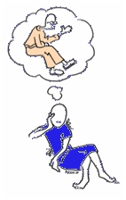
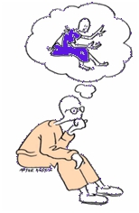
Cohort Effects in Preferences for Healthcare Choices
Lagana & Shanks, 2002; Sharma et al., 2011

Slide 39
Aging is Multidimensional
Cognition
Goals and emotions
Time horizons
Cohort effects
Aging stereotypes

Slide 40
Aging Stereotypes
Among patients:
May inhibit cognitive performance (stereotype threat)
May lower outcome expectations for treatments
Among providers:
May prevent effective communication
May limit treatment suggestions

Slide 41
Aging is Multidimensional
Cognition
Goals and emotions
Time horizons
Cohort effects
Aging stereotypes

Slide 42
Today’s Talk
Misconceptions about decision making
Misconceptions about aging
Overview of age-related changes in decision making
Implications for pain management

Slide 43
Decision Making as a Process
Need Definition/
Problem Recognition
Information Search
Information Evaluation/
Strategy Selection
Should I stay …
… or should I go?
Outcome Evaluation

Slide 44
Need Definition/
Problem Recognition

Slide 45
Need Definition/ Problem Recognition
Compared to younger adults, older adults are more likely to:
Avoid choices
Postpone choices
Delegate choices
(e.g., Chen et al., 2011; Pinquart & Duberstein, 2004)

Slide 46
Need Definition/
Problem Recognition

Slide 47
Need Definition/
Problem Recognition
Information Search

Slide 48
Information Search Declines with Age
(e.g., Löckenhoff & Carstensen, 2007; Mata & Nunes, 2011)

Slide 49
Types of Information
Younger adults are more likely to perform an exhaustive review of the available information
Older adults are more likely to rely on:
Existing cognitive frameworks
General background knowledge
Prior experiences
(Gilinsky & Judd, 1994; Gould, 1999; Berg et al. 1999)

Slide 50
Preferences for Choice Decline with Age

Slide 51
Preferences for Choice Decline with Age

Slide 52
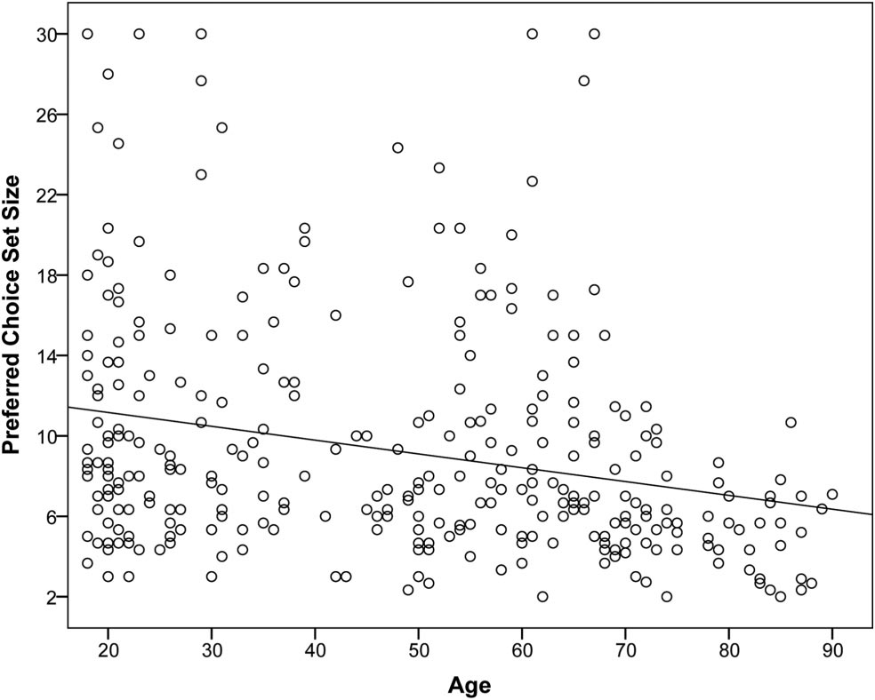
Preferences for Choice decline with Age
How many options would you like to choose from?
(Reed, Mikels, & Löckenhoff, 2013)

Slide 53
Need Definition/
Problem Recognition
Information Search
Information Evaluation/
Strategy Selection

Slide 54
Decision Strategies
Younger adults use
compensatory strategies (lower scores on some aspects can be compensated by higher scores on others)
Older adults use
non-compensatory strategies (focus on select aspects)
satisficing strategies (select first option that meets minimal standard)
(e.g., Johnson, 1990)

Slide 55
Information Search becomes less Compensatory & more Satisficing with Age

Slide 56
The Age-Related Positivity Effect
Charles, Mather & Carstensen, 2003

Slide 57
The Positivity Effect in Decision Making
(e.g., Löckenhoff & Carstensen, 2007; 2008)

Slide 58
The Positivity Effect in Decision Making
Proportion of Positive Cells
Löckenhoff & Carstensen, 2007 – Psychology and Aging

Slide 59
Need Definition/
Problem Recognition
Information Search
Information Evaluation/
Strategy Selection
Should I stay …
… or should I go?
Outcome Evaluation

Slide 60
Decision Quality and Outcome Satisfaction
Age differences in objective decision quality depend on task type
Older adults perform worse in decisions involving new learning and effortful processing (cognitive mechanics)
Older adults perform well in decisions involving experience and affective preferences (cognitive pragmatics)
Older adults are more satisfied with their choices, less likely to report regret

Slide 61
Aging & Decision Making
Need Definition/
Problem Recognition
Information Search
Information Evaluation/
Strategy Selection
Should I stay …
… or should I go?
Outcome Evaluation

Slide 62
Today’s Talk
Misconceptions about decision making
Misconceptions about aging
Overview of age-related changes in decision making
Implications for pain management

Slide 63
Need Definition/
Problem Recognition
Select appropriate default options
Know the patient’s decision control preferences and decision support network
Avoid information overload
Provide key information in through multiple channels
Ensure that negative information is not overlooked
Be aware of common heuristics and their possible pitfalls
Probe for faulty beliefs about pain management
Use logs, diaries, or electronic monitoring to track adherence and outcomes
Information Search
Information Evaluation/
Strategy Selection
Should I stay …
… or should I go?
Outcome Evaluation

Slide 64
Example: Joint Replacement

Slide 65
Example: Joint Replacement
Riffin, Pillemer, Reid, Tung, & Loeckenhoff, 2016

Slide 66
Example: Joint Replacement
Riffin, Pillemer, Reid, Tung, & Loeckenhoff, 2016

Slide 67
Example: Joint Replacement
Correlates of lower willingness to have TJR:
Older age
More limited time horizons
➔ Unrelated to stereotypes about own aging
Riffin, Ratner, Loeckenhoff et al., in preparation

Slide 68
Today’s Talk
Misconceptions about decision making
Misconceptions about aging
Overview of age-related changes in decision making
Implications for pain management

Slide 69
Feb. 27, 2017 | 1pm-2pm EST:
Presenter: Gregory Samanez-Larkin, PhD, Yale University
Applying Research on Financial Decision Making in Aging to Social & Health Domains
March 27, 2017 | 1pm-2pm EST:
Presenter: Liana Fraenkel, MD, MPH, Yale University
Innovative Ways to Incorporate Patient Preferences into Medical Decision-Making
April 24, 2017 | 1pm-2pm EST
Presenter: Jon Lurie, MD, Dartmouth University
Patient Expectations & Decision Support Strategies in Pain Care
May 22, 2017 | 1pm-2pm EST
Presenter: Adam Hirsh, PhD, Indiana University-Purdue University Indianapolis
Racial & Ethnic Pain-Related Disparities: Provider & Contextual Factors & Potential Solutions
June 26, 2017 | 1pm-2p, EST
Presenter: Joseph Kable, PhD, University of Pennsylvania
The Impact of Expectations & Persistence on Achieving Long Term Goals

Slide 70
Further Reading
Löckenhoff, C.E., Hsiao, C., Kim, J., & Swarts, K. (2016). Adult age differences in health-related decision making: A primer. In M. Diefenbach, D. Bowen, S. Miller (Eds.). Handbook of health decision science. Springer.
Communicating with Older Adults: Recognizing Hidden Traps in Health Care Decision Making. Washington, DC, 2016. https://goo.gl/kWrnSR
Hess, T., Strough, J., & Löckenhoff, C.E. (Eds.). (2015). Aging and decision making: Empirical and applied perspectives. Elsevier.

Slide 71
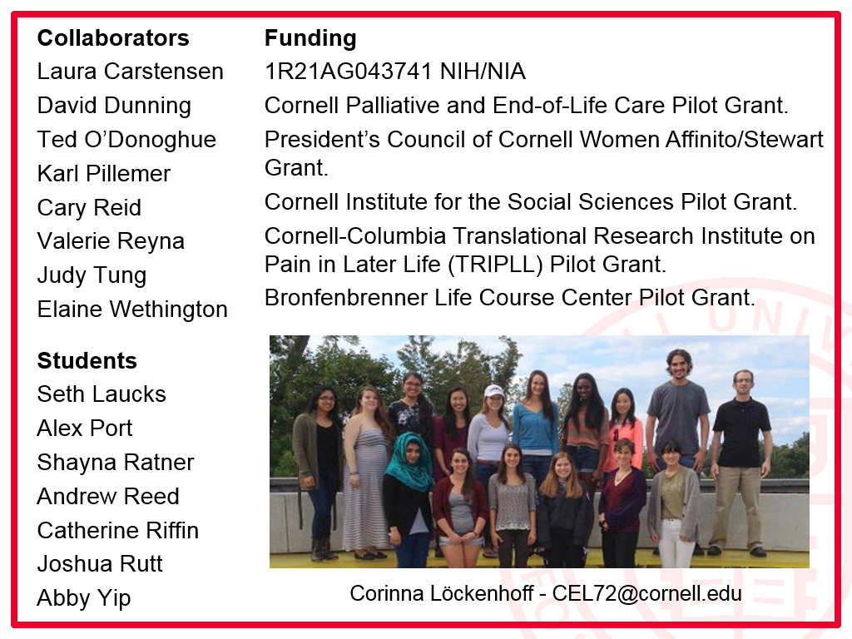

Slide 72
?

Slide 73
How to get involved with TRIPLL
Join our email list and consider becoming an affiliate
Receive access to:
Monthly newsletter
Work-in-Progress seminars, webinars, funding, and conference announcements
Networking opportunities
Visit tripll.org or email Cara Kenien at cak2017@med.cornell.edu

